Slide 1
School's provide amazing support for Service children across Wales. Keep colleagues, parents, children and visitors to your school informed about the support you offer for Service children.
How to use this tool:
This tool has been produced to provide ideas on how you can advertise the Service children provision you run in school.
Instructions:
Use the examples provided to inspire ideas for your own display board.
Include your Service children in designing and creating the display.
Regularly review and update the content in collaboration with your Service children and Armed Forces community.
GUIDANCE: Promoting school support for Service children

Slide 2
Service Children Ambassador information
Name/s
Image/s
Information on the role
Club activities
Photographs
Reports
Event reminders
Service Children School Champion information
​
Name
Image
Where to find them
Armed Forces Friendly School Award
Certificate
Celebration photos
Club information
Club name
Days and times
Location
Work examples
Artwork
Poetry
Images
Events
Month of the Military Child
Armed Forces Day
Remembrance
Links to Armed Forces Community
​
Insignia
Flags
World clocks

Slide 3
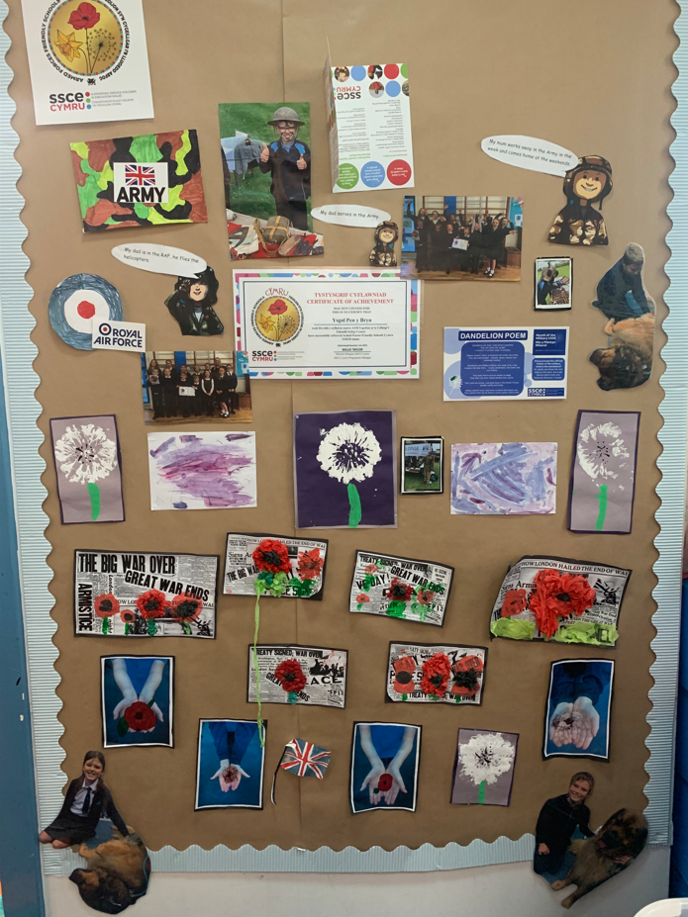
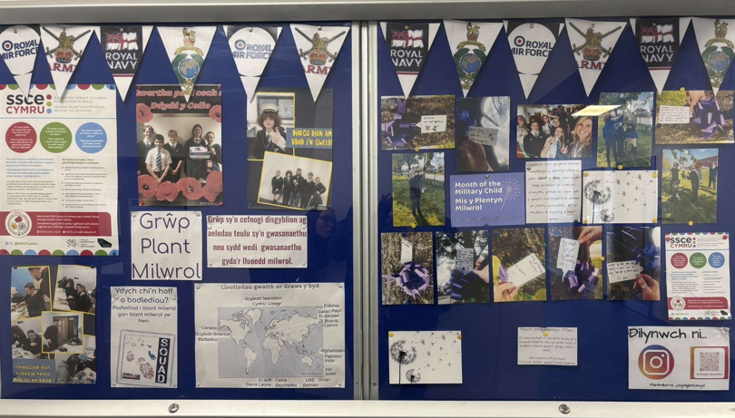
Service children school display examples

Slide 4
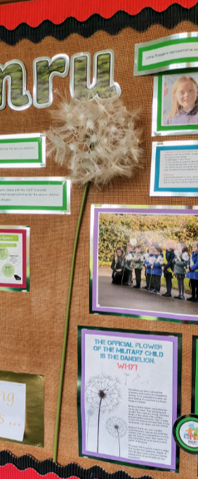
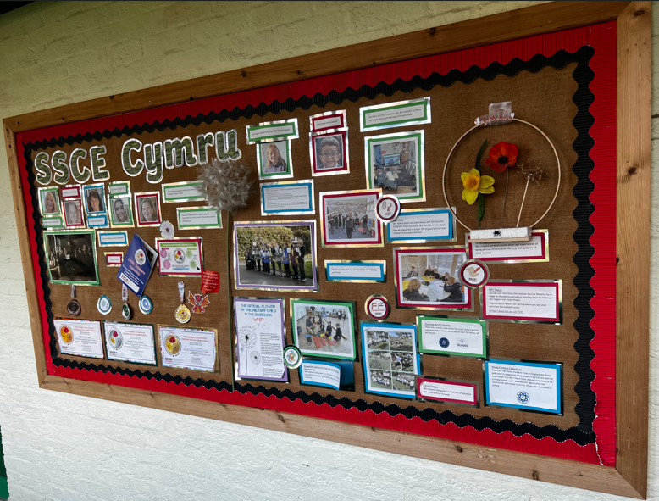
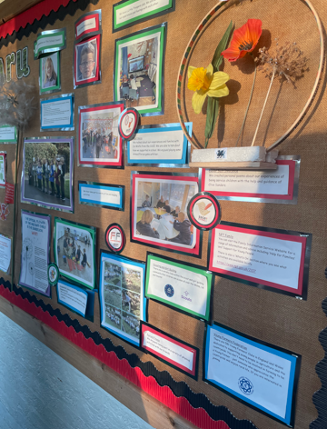
Service children school display examples

Slide 5
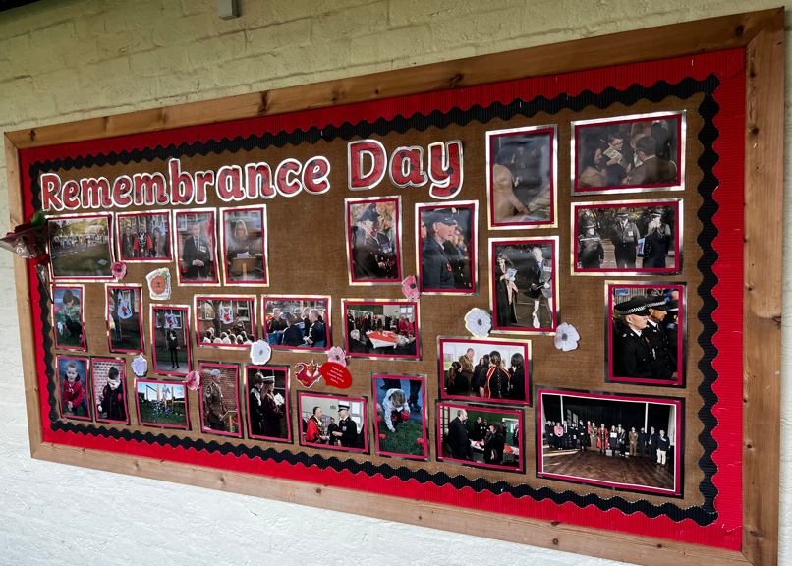
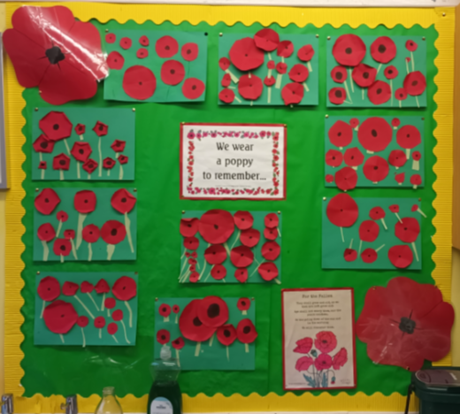
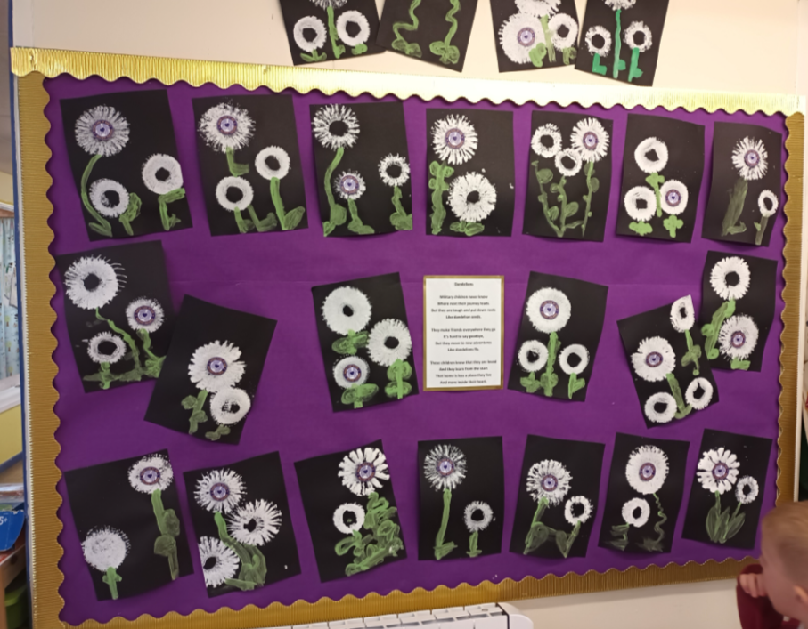
Service children school display examples

Slide 6
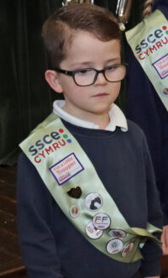
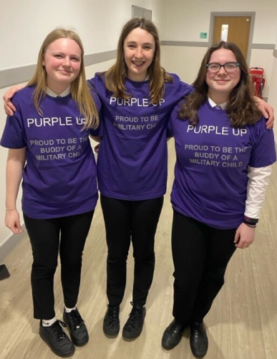
Service children club design activities
Poster
Logo
Merchandise
Design a poster for your Service children club. You should consider including:
Name of club ​
About information e.g. the purpose of the club, what activities you do, benefits of the club
Relevant images e.g. logo, photos
Tagline
Date and time - when does the club meet
Location - where does the club meet
Leaders e.g. Service Children School Champion (staff) and Service Children Ambassador/s (student/s)
Design a logo for your Service children club. You should consider including:
Name of club
Reference to the school / Armed Forces Icon
Tagline / Motto
Digital or by hand
You could also consider designing a range of other merchandise for your club e.g.
T-shirts / hoodies
Badges
Sashes
Banners
Dandelions, poppies and daffodils

