Slide 1
Taking the time to listen enhances understanding and ensures that educators involve Service children in activities, events, and resources to better support them.
How to use this tool:
This document contains guidance on;
Tailoring pupil voice for Service children
Service children clubs and resources
Supporting Service children in becoming SSCE Cymru Ambassadors
Instructions
Work through the guidance in collaboration with the information on the SSCE Cymru website and with support from the SSCE Cymru team.
GUIDANCE / TEMPLATE: Service children pupil voice

Slide 2
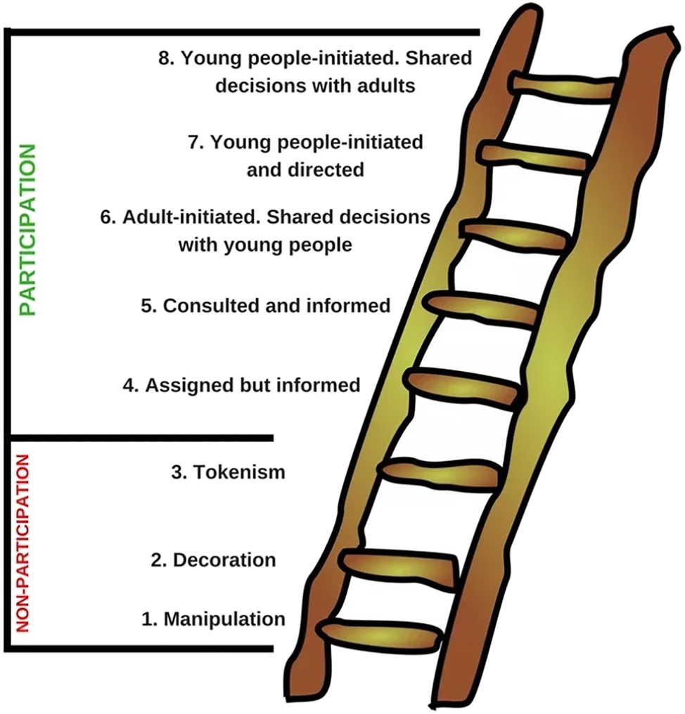
Tailoring pupil voice for Service children
There are a range of tools and guidance available to support pupil voice initiatives. You may find the following useful;
Finding your voice – Confidence in the community, Barnardo's Cymru
Children and Young People's Participation in Wales, Good Practice Guide
Children's Commissioner for Wales
In preparation for pupil voice sessions with Service children and young people consider completing the SSCE Cymru e-learning training package which has been designed to give educators the tools and confidence to better understand and support the needs of Service children. This will help you to prepare pupil voice sessions which are tailored to Service children.
SSCE Cymru e-learning
Adapted from: HART, R (1992) Children's participation: From tokenism to citizenship.
SSCE e-learning quote: “It was very interesting to learn about the different mobility, deployment and transitions that families experience.”
Consider tailoring opportunities around significant Armed Forces events e.g. Remembrance, MotMC, Armed Forces Day
Ask Service children what additional support they feel they might benefit from.
Share armed forces family experiences with non-service children and staff

Slide 3
Service children clubs
Service children clubs provide a wonderful opportunity for Service children to come together, sharing their unique experiences in a safe and familiar environment. Supported by a dedicated staff member, known as the Service Children School Champion (SCSC), schools create a welcoming space to address the distinct challenges faced by Service children, such as deployment, weekly separation, and frequent relocations. This role helps foster strong relationships between students, staff, and peers, while also offering exciting opportunities to celebrate their military lifestyle, experiences, and special events, such as the Month of the Military Child.
Across Wales, schools run Service children clubs in various ways to best support their Service children and align with the needs of the school. These clubs may take place during lunch time or after school, and can be held weekly, fortnightly, or half-termly, often corresponding with key events.
Please see the SSCE website for examples of Service children clubs in schools across Wales.
SSCE Cymru enjoy collaborating with other organisations that want to support Service children and pupil voice. You can find links to a range of information and resources for running Service children clubs on the SSCE Cymru SCSC Resources Padlet.
The padlet is broken down into eight sections, all with links to direct you to helpful resources:
SSCE Cymru: website, tools webpage and the e-learning
Voice of the child and training
Primary resources
Secondary resources
Information to support Armed Forces families
Month of the Military Child
Armed Forces Day
Remembrance.
Resources

Slide 4
Service children pupil resources
SSCE Cymru Tools
Calendared Events
SSCE Cymru enjoy collaborating with other organisations that want to support Service children and pupil voice. You can find links to a range of information and resources for running Service children clubs on the SSCE Cymru Padlet.
A number of the SSCE Cymru tools have been designed to be used with Service children in both an individual or club setting to capture their voice.
6a – Service children to create Welcome Pack for new Service children using the template / information provided in Tool 6a.
Tool 8 – Getting to know you activity completed in Service children club OR Service children to
create there own list of questions they’d like to be asked as Service children using examples from tool 8.
Tool 9 – Service children create a journal/record book using relevant slides from tool 9 to document important events, memories, and check ins throughout their school experience.
Tool 11 – Service children to create a presentation / assembly on Service children.
Tool 12 – Service children to be involved in the creation of their display board and poster competition
Good opportunities for pupil voice sessions are key calendar dates for the Armed Forces community.
April – Month of the Military Child
June – Armed Forces Day
November – Remembrance

Slide 5
Service children Ambassadors
If your school has an established club or you have just one or two Service children on role, SSCE Cymru encourages any Service children to consider volunteering to be an Ambassador. As an ambassador, they will represent your school and be added to a growing network of Service children Ambassadors. They may be invited to share their experiences of growing up in an Armed Forces family with our team and the SSCE Cymru network, giving them an important voice for other Service children and young people in Wales.
Being an ambassador provides valuable experience working with educators, organisations, charities, and policy makers. When relevant opportunities arise, and their experiences align with specific needs, our team may contact the school’s Service Children School Champion to invite the Ambassador to participate in various activities. These could include:
Creating short video clips to share experiences on our website, webinars, or social media
Participating in pupil voice sessions
Helping update our school tools or resources
Attending national conferences, forums, forces festivals, or military events (on rare occasions)
Any involvement in these activities will be arranged through the school, with the necessary consent in place beforehand.
Who can be a Service children ambassador?
Any child or young person who:
has a connection to the Armed Forces
is currently in education in Wales
How to become an ambassador?
Find out more about how to become an ambassador and what it is like via the Clubs and ambassadors page.
Being an Ambassador
Meet a Service children Ambassador (add link to website)

