Slide 1
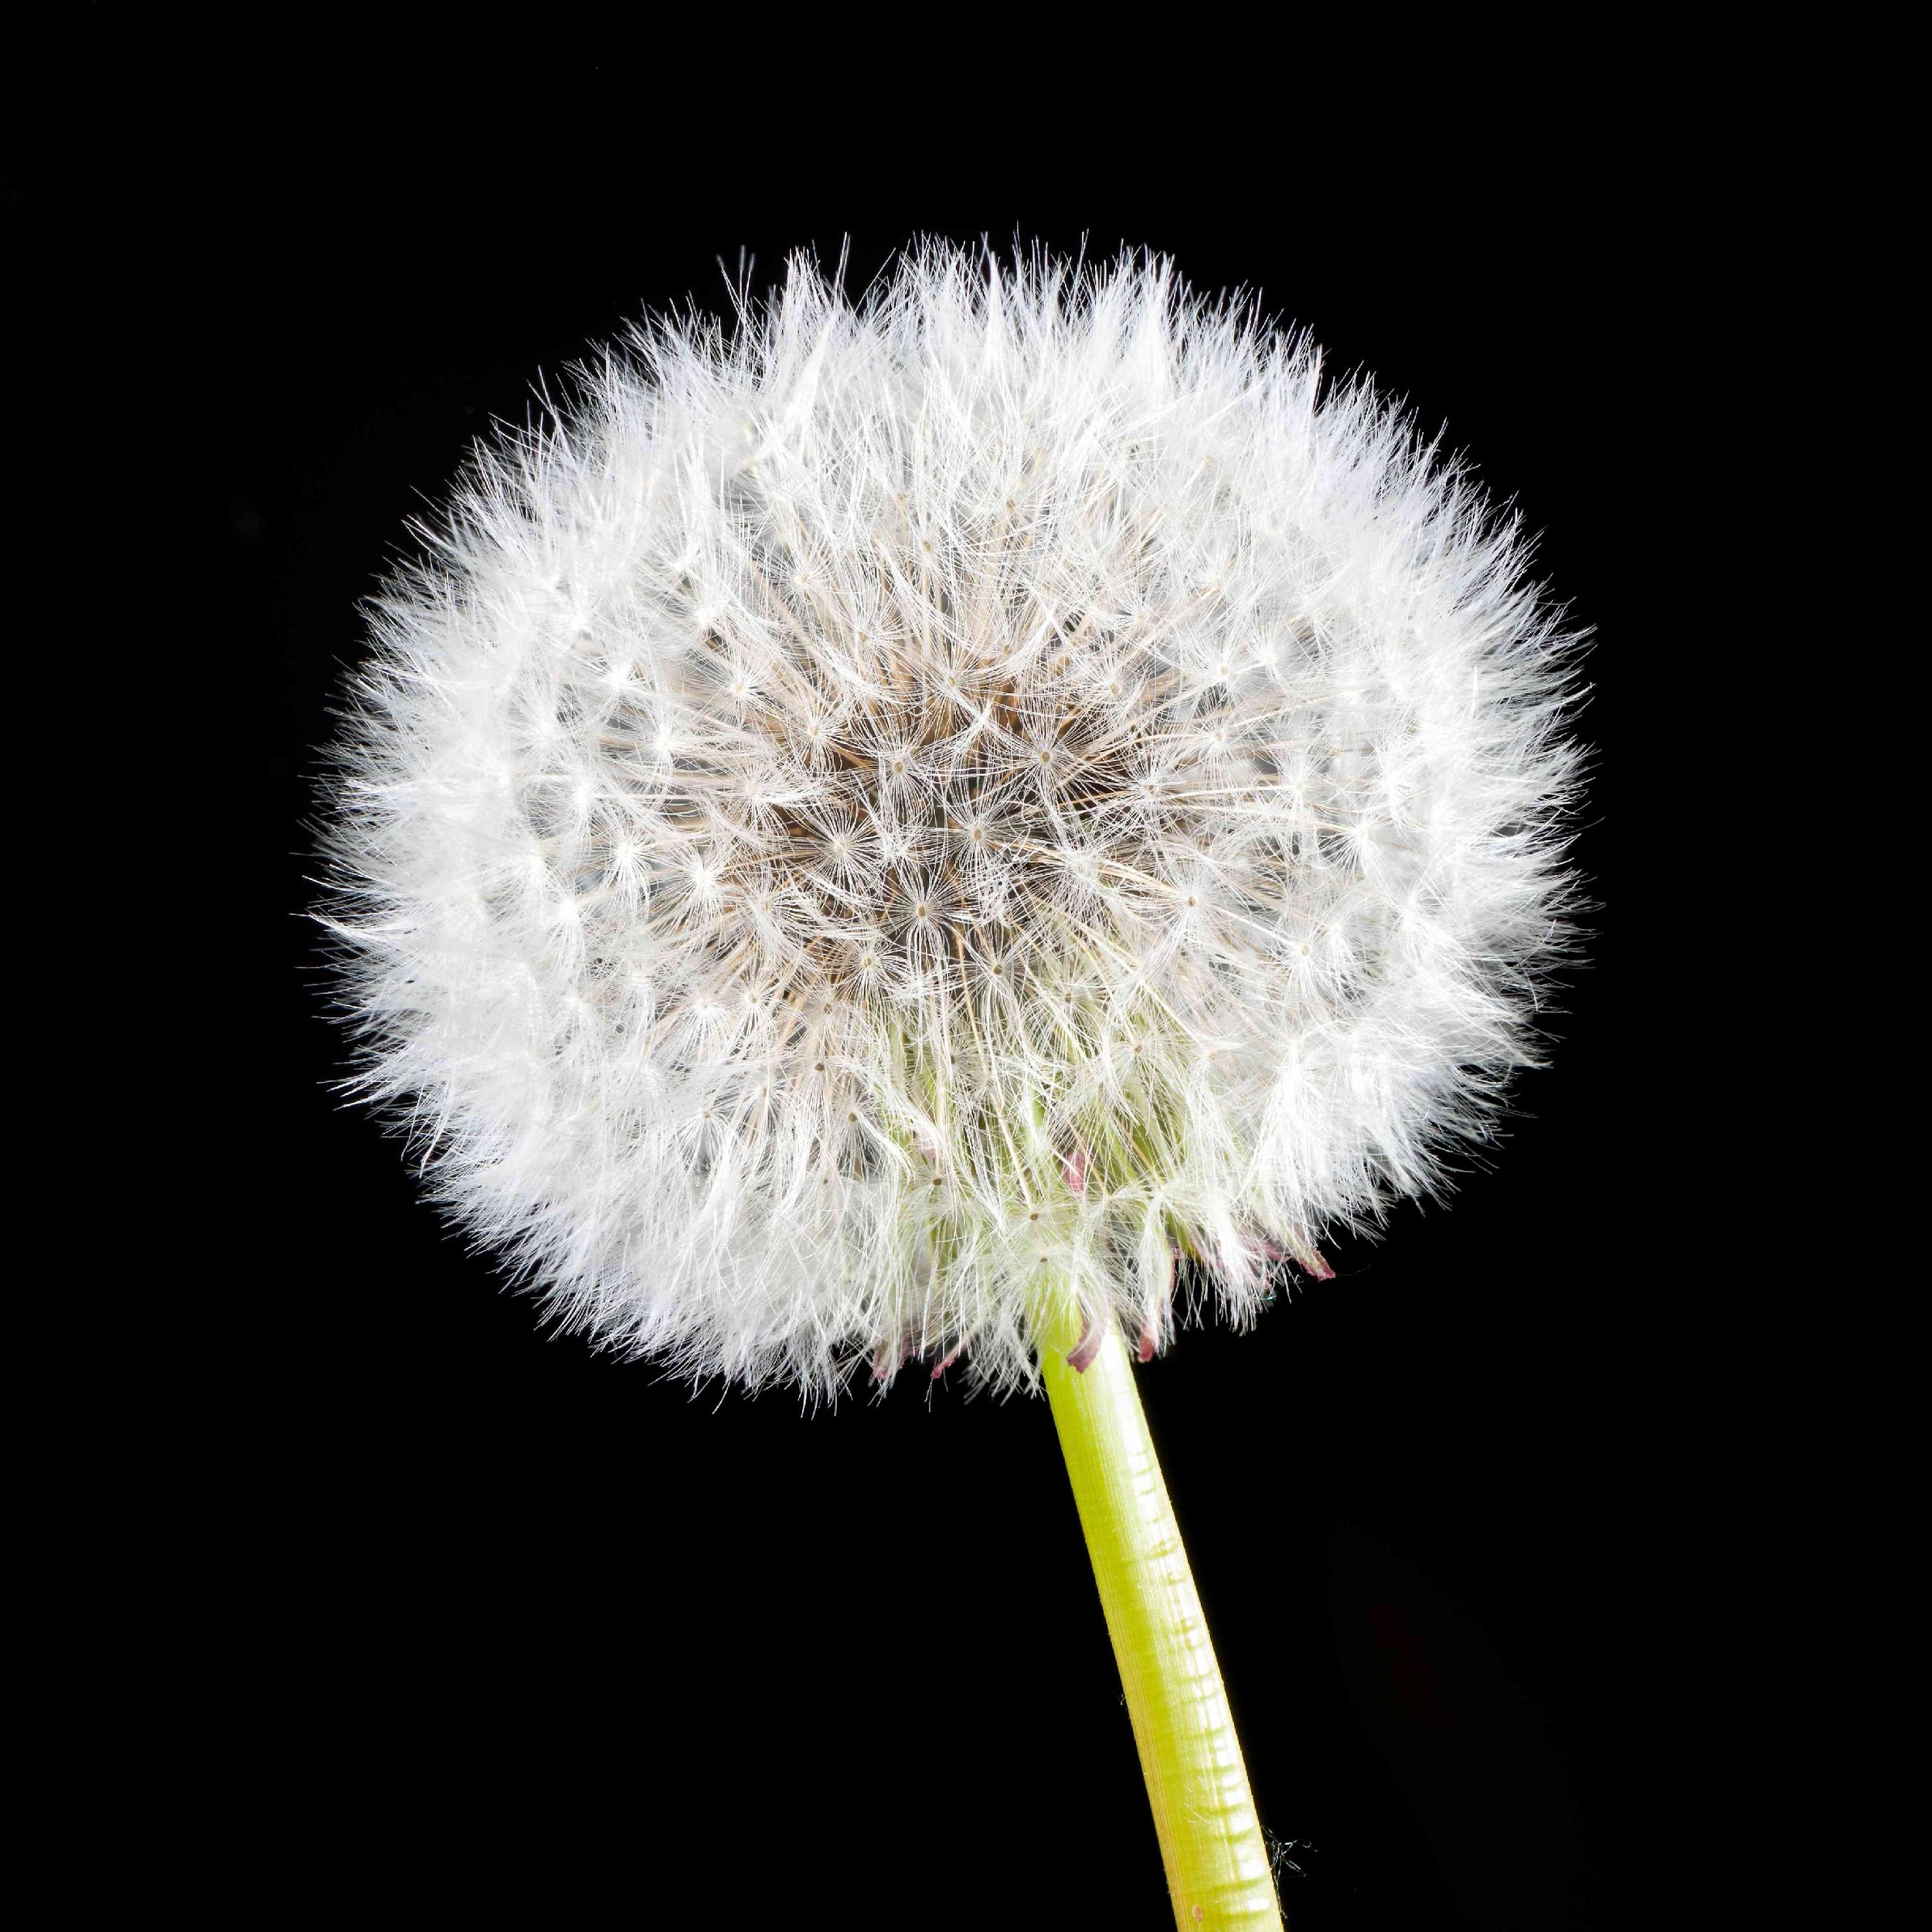
Dandelions put down roots almost anywhere,
They are hardy and upright,
A survivor in a broad range of climates.
Military children bloom everywhere the winds carry them,
They are well-rounded, culturally aware, tolerant and
extremely resilient.
Dandelions and Military Children are ready to fly in the
breezes that take them… to new adventures, new lands and
new friends.
They learn that to survive means to adapt,
That when one door closes another door opens.
Their roots are strong, cultivated deep in the Armed Forces,
planted swiftly and surely.
Military children know that home is where their hearts are,
That a good friend can be found in every corner of the world.

