Slide 1
Due to the nature of the Armed Forces lifestyle it is important to find ways to support Service children through check-ins and recording memories.
How to use this tool:
These templates can be used as an ongoing journal to document a Service child's school experience. Section 1 Check-ins provides templates to support staff check in with Service children at times of need. Section 2 Memories and Messages includes template slides to record images, messages, memories etc of important events/milestones in the Service child's school experience. Section 3 Moving schools focuses on supporting Service children who move schools. It is designed to be completed through collaboration between the Service child and staff in both individual and Service children group settings.
Instructions:
Copy and paste / print the relevant slides for completion with the Service child/ren.
Add the information, images etc (ideas are in red).
Continue to add to the journal throughout their school experience.
Save in your chosen format.
TEMPLATES: Service children journal

Slide 2
Check in
Section One
Advice for this section
This section provides a range of check-in templates. Due to the impact of the Armed Forces lifestyle Service children may require additional check-ins with staff to support their emotional wellbeing. This support may be required at a variety of times e.g.
Transition – relocating, moving house, school etc
Deployment – long periods with Serving parent/s away from home
Weekending – adjusting to different family dynamics, difficulties saying goodbye every weekend
Special occasions / events – Serving parent/s away for Christmas, birthdays, school events
As well as general templates you will also find specific templates e.g. worry monster and count down calendar.
These templates can be used with individual Service children or as part of an activity for a Service children club.
The SSCE Cymru Padlet also includes links to further check-in resources such as Little Troopers X-Ray of Feelings.

Slide 3
Check in
Transition process
After the first day/four weeks/term etc at my new school I'm feeling...
"I'm happy and excited" | "I'm feeling ok." | "I'm a little bit worried." | "I'm feeling nervous." | "I'm very angry and/or worried."
Notes
Add information from a discussion

Slide 4
Check in
Deployment / Exercise / General
How are you feeling?
"I'm happy and excited" | "I'm feeling ok." | "I'm a little bit worried." | "I'm feeling nervous." | "I'm very angry and/or worried."
Notes
Add information from a discussion

Slide 5
Check in
Special Occasions / Events
How are you feeling?
"I'm happy and excited" | "I'm feeling ok." | "I'm a little bit worried." | "I'm feeling nervous." | "I'm very angry and/or worried."
Notes
Add information from a discussion

Slide 6
Check in
Transition process
After the first day/four weeks/term etc at my new school I'm feeling...
Notes
Add information from a discussion

Slide 7
Check in
Deployment / Exercise / General
How are you feeling?
Notes
Add information from a discussion

Slide 8
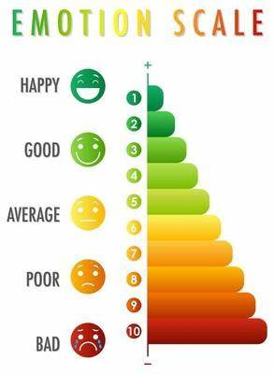
Check in
Special Occasions / Events
How are you feeling?
Notes
Add information from a discussion

Slide 9
Check in
Three good things

Slide 10
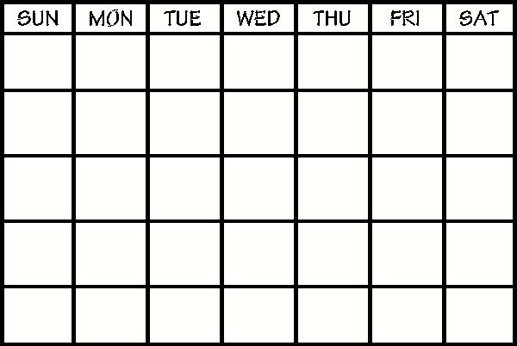
Check in
Count down calendar
Things to talk about
Add information from a discussion
Things to look forward to
Add information from a discussion

Slide 11
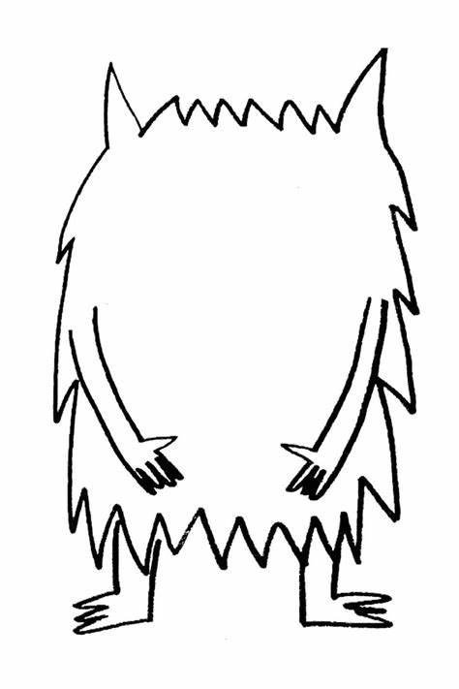
Check in
Worry monsters
Draw your worries monsters mouth.
Write down or draw any worries you have in the worry monsters mouth.
Let him eat them all up.

Slide 12
Memories and messages
Section Two
Advice for this section
This section provides a number of templates with space to record memories and messages of important events that have occurred during the Service child's school experience. Below is a list of examples;
First day of school
Assemblies
Sports Day
School trips / residentials
Calendared events (St David’s Day, Eisteddfod, World Book Day, MotMC)
Favourite things about school
It can be particularly important to record these memories and messages for Service children. For example, if Serving parent/s are away the memory can be shared with them at a later date. Equally, if the Service child regularly moves school the memories and messages can be recorded in different settings.
These templates can be used with individual Service children or as part of an activity for a Service Children Club.

Slide 13
Memories and messages - (add name of school)
Add photo and details e.g. photos of the school, student, teachers, school pet, school mascot, memorable event in school etc
Add photo and details e.g. photos of the school, student, teachers, school pet, school mascot, memorable event in school etc
Add photo and details e.g. photos of the school, student, teachers, school pet, school mascot, memorable event in school etc
Add information linked to the images and how they are important.

Slide 14
Memories and messages - (add name of school)
Add photo and details e.g. photos of the school, student, teachers, school pet, school mascot, memorable event in school etc
Add photo and details e.g. photos of the school, student, teachers, school pet, school mascot, memorable event in school etc
Add photo and details e.g. photos of the school, student, teachers, school pet, school mascot, memorable event in school etc
Add photo and details e.g. photos of the school, student, teachers, school pet, school mascot, memorable event in school etc
Add photo and details e.g. photos of the school, student, teachers, school pet, school mascot, memorable event in school etc
Add photo and details e.g. photos of the school, student, teachers, school pet, school mascot, memorable event in school etc

Slide 15
Memories and messages - (add name of school)
Add message from friend/staff member
Add message from friend/staff member
Add message from friend/staff member
Add message from friend/staff member
Add message from friend/staff member
Add message from friend/staff member

Slide 16
Memories and messages - (add name of school)
Add photo and message from friend/staff member
Add photo and message from friend/staff member
Add photo and message from friend/staff member
Add message from friend/staff member

Slide 17
Memories and messages - (add name of school)
My best memory of this school is -
I will miss -
My FAVOURITE things about school
Add photo and details - information on Service child's current age, year group, class etc.
Subject -
Food from the canteen
Place in the school -
My biggest achievement -
Teacher -

Slide 18
Moving schools
Section Three
Advice for this section
This section provides a number of templates designed to support Service children with moving schools.
Some Service children move schools multiple times due to a Serving parent/s posting or following their departure from the Armed Forces. During this uncertain time, it is important to plan ahead and support the Service child/ren with familiarising themselves with their new school. Similarly, reflecting on their time at their current school ensuring they have memories of and messages from school staff and friends to take with them is important. The templates focus on:
About me, to and from schools
Getting to know me
Goodbye messages and memories
Preparing for the move
New school research
Moving schools check-in
You could also consider ways to commemorate the Service child’s last day e.g. a goodbye party, a gift such as dandelion seeds, a leaving book (made up of some of these templates).

Slide 19
Moving schools
About me
To...
My name is ….
I am …. years old.
I currently live in …. with my …..
I am moving to …... in …..
We are moving here because ….
Add school name and photo/logo
Add date (first day at school)
From...
I am excited about....
Add school name and photo/logo
I am nervous about ...
Add date (last day at school)
….

Slide 20
Moving schools - getting to know me
I am good at …
I'd like to be better at …
My FAVOURITE things are ...
My best friends are - add information
I met my friends when - add information
With my friends I like to – add information
Sport -
Film -
Book -
Other -
TV Show -

Slide 21
Moving schools - getting to know me
Add photo and details e.g. Me with my mum and dad, friends, at an event, piece of work I am proud of, in front of my current house etc
Add photo and details e.g. Me with my mum and dad, friends, at an event, piece of work I am proud of, in front of my current house etc
Add photo and details e.g. Me with my mum and dad, friends, at an event, piece of work I am proud of, in front of my current house etc
Add photo and details e.g. Me with my mum and dad, friends, at an event, piece of work I am proud of, in front of my current house etc
Add photo and details e.g. Me with my mum and dad, friends, at an event, piece of work I am proud of, in front of my current house etc
Add information linked to the images and how they are important at this phase of life.

Slide 22
Moving schools - goodbye messages
Add message from friend/staff member
Add message from friend/staff member
Add message from friend/staff member
Add message from friend/staff member
Add message from friend/staff member
Add message from friend/staff member

Slide 23
Moving schools - goodbye messages and memories
Add photo and message from friend/staff member
Add photo and message from friend/staff member
Add photo and message from friend/staff member
Add message from friend/staff member

Slide 24
Moving schools – preparing for the move...
In month year I will be starting my new school school name in location
I am excited about my new school because add information
I am nervous about my new school because add information
The clubs / groups I hope to join are add information
Things that will help me settle into my new school are add information
Things I would like to know about my new school are add information

Slide 25
Moving schools - my new school research
Add information
I have been researching my new school online and have found out
Add information
Add information
Add information
Add information
Add information
Add information
Add information

Slide 26
Moving schools - my new school research
Add photo and information on the new school. This could be taken from the website, a visit or details shared by the new school e.g. building, map, teachers, mascots, school pets.
Add photo and information on the new school. This could be taken from the website, a visit or details shared by the new school e.g. building, map, teachers, mascots, school pets.
Add photo and information on the new school. This could be taken from the website, a visit or details shared by the new school e.g. building, map, teachers, mascots, school pets.
Add photo and information on the new school. This could be taken from the website, a visit or details shared by the new school e.g. building, map, teachers, mascots, school pets.

Slide 27
Moving schools - my new school research
Add photo and information on the new school. This could be taken from the website, a visit or details shared by the new school e.g. building, map, teachers, mascots, school pets.
Add photo and information on the new school. This could be taken from the website, a visit or details shared by the new school e.g. building, map, teachers, mascots, school pets.
Add photo and information on the new school. This could be taken from the website, a visit or details shared by the new school e.g. building, map, teachers, mascots, school pets.
Add photo and information on the new school. This could be taken from the website, a visit or details shared by the new school e.g. building, map, teachers, mascots, school pets.
Add photo and information on the new school. This could be taken from the website, a visit or details shared by the new school e.g. building, map, teachers, mascots, school pets.
Add photo and information on the new school. This could be taken from the website, a visit or details shared by the new school e.g. building, map, teachers, mascots, school pets.

Slide 28
Moving schools – check in
My best memory so far...
My biggest achievement so far
My FAVOURITE things so far are ...
How do you feel you have settled in? add information
Do you have any worries? add information
Do you have any questions? add information
Subject -
Food from the canteen -
Place in the school -
Extra curricular activity
Teacher -

