Slide 1


A Service children pupil voice initiative ensuring local authorities listen to the voices of Service children, enhance their educational experiences, and strengthen their commitment to inclusion, support and the Armed Forces Covenant.
SSCE Cymru Service Pupil Promise - A structured approach to gathering Service children’s voices enabling the creation of a Local Authority Service Pupils’ Promise

Slide 2

What is a Service Pupil Promise
A Service Pupil Promise is a commitment from the Local Authority to support children from Armed Forces families, ensuring we listen to their voices, and strengthen the LAs commitment to the Covenant.
The initiative includes a Service pupil voice workshop event which aims to ensure that Service children receive the recognition and tailored support they deserve, acknowledging the unique challenges they face, such as mobility, separation, and transition between schools.
The aim is to include a diverse range of Service Children from schools across the LA, so to gather a wide variety of perspectives and experiences. The workshop event allows Service children to interact and socialise with other Service Children from across the county as well as networking opportunities for school staff.
Notes:
Explain what the SPP is and what we aim to achieve.

Slide 3

What is a Service Pupil Promise
Following the event all information is collated and reflected upon and the Service Pupil Promise is written up.
Follow up school visits / work with Service children can then take place to finalise the Service Pupil Promise with Service children before publication.
By working together this framework, the Promise, is created and enhances Service children's educational experience and strengthens the local authority’s commitment to inclusion and support.
The initiative is aimed at KS2 and KS3 Service children. Ideally there should be a minimum of 25 SC in attendance.

Slide 4
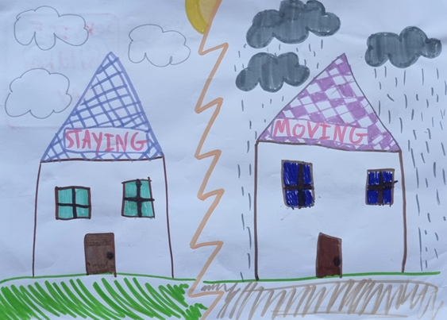
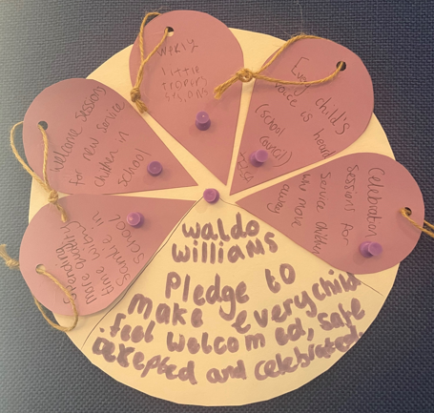
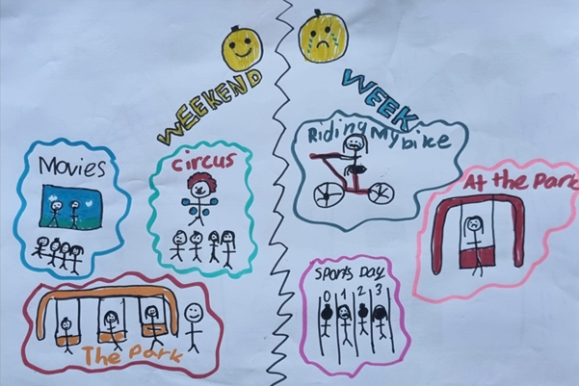
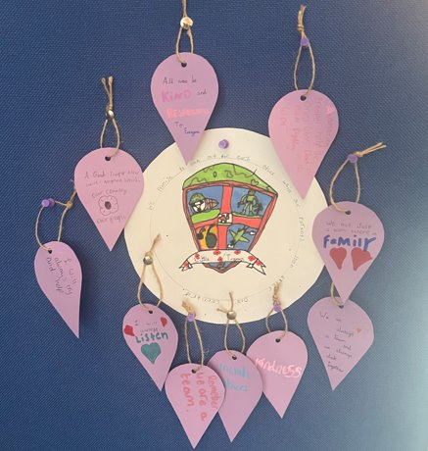
PILOT – Pembrokeshire Service Pupil Promise
In June 2025, Pembrokeshire County Council proudly hosted Wales’ first Service Pupil Promise event, giving 60 Service children a voice to shape how schools and the county council support them.
During the event, hosted at Wolfscastle Hotel, students enjoyed a range of creative and reflective tasks. This culminated in the creation of individual school pledges e.g. “We promise to look out for each other while our parents look after our country.”
The event also gave the staff from schools (Service Children School Champions) the opportunity to network and share best practice.

Slide 5
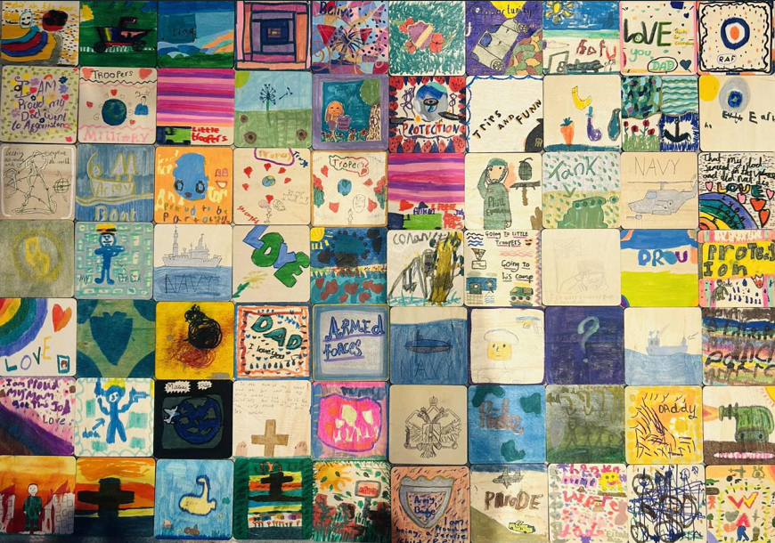
LA wide Service children workshop event
Arrival and Welcome – Ice breaker, welcome speech, introductions, overview of the day.
Hearing Service children's views – Poem, video activities
Pros and cons - What are the advantages and disadvantages of being a ‘Service child’?
Celebrating Success - What does your current school do well, or what did previous schools do well, to celebrate your Service child experiences / lives and to support you as a Service child?
Identifying and overcoming challenges – What are the main barriers/challenges? What could schools do to help overcome these? Big Empathy Drawings, Videos, Assemblies.
Improving provision – School/Group Pledge, our vision for the perfect school, post card request to headteacher / council.
Reflection – should schools treat Service children any differently to other pupils?
The Service Pupil Promise initiative includes a event, a Service children pupil voice workshop lasting approximately 4-5 hours. It will include activities based on the themes listed here.
Notes:
The main event includes a range of activities based on the themes listed.

Slide 6

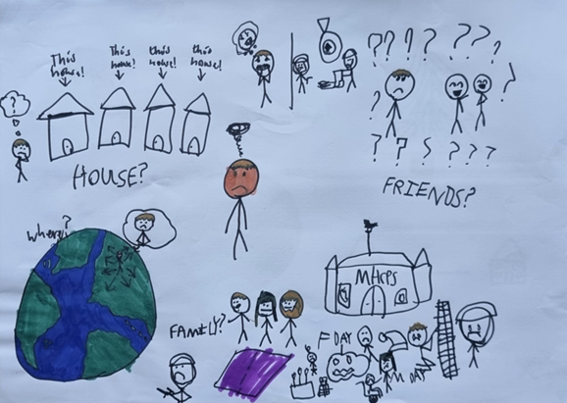
LA wide Service children workshop event

Slide 7

PILOT – Pembrokeshire Service Pupil Promise
The information from the event was collated and reflected upon and the Pembrokeshire Promise was written over the summer.
It was launched at the Armed Forces Festival West Wales as a number of the children who had been involved in the workshops were present.

Slide 8
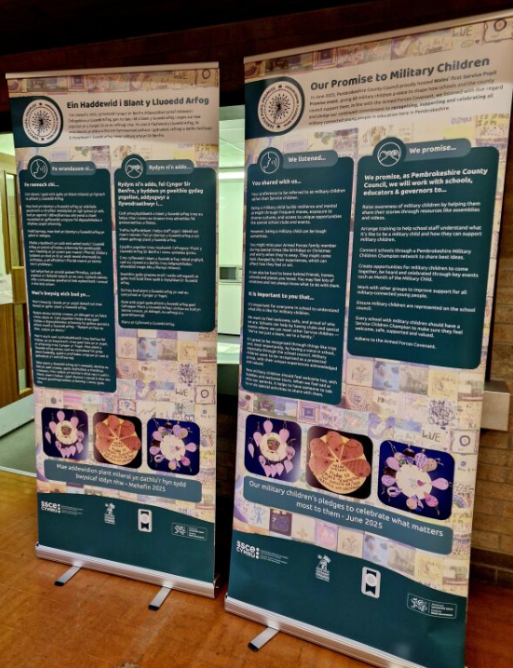
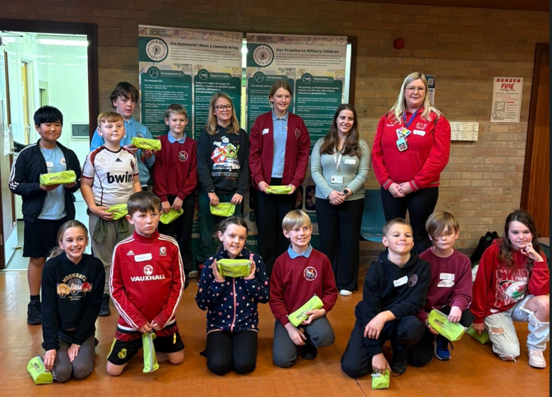
What next?
The eventual aim is to create a Service Pupil Promise with every LA.

Slide 9
Service Pupil promise – Initial Planning
How will you be supported?
SSCE Cymru will provide a checklist and all template resources required for the workshop/s as well as the production of the final Service Pupil Promise.
You will be supported by the SSCE Cymru team in the planning, delivery and write up of your LA Service Pupil Promise.
SSCE Cymru will support with funding. This could be used to cover the costs of a venue, food, resources, staff/staff cover, transport etc.
Who, where, when?
The Service Pupil Promise event has been created with KS2 and 3 children in mind although KS4 could certainly be involved (in the activities themselves or to support with facilitating). We recommend at least 25 Service children are involved so a range of experiences can be gathered but the number could be far greater. Our pilot event included 60 SC.
Other than that, consider what will work best for you as a LA.
Who - You may wish to include a small number of SC as representatives from as many schools across your LA as you can. You equally may wish to invite and include every SC and run a much larger event.
What – templates of resources are provided from which you can choose activities. Depending on your choices you may need to print and order additional physical resources. You may wish to provide food e.g. a pizza van. You could consider using funding to buy a small gift for your SC.
Where – Depending on numbers and logistics you could consider using a school hall, youth centre, local Armed Service building e.g. cadets, or even a fancy hotel.
When – when suits you? You may wish to tie the event or publication of the Promise in with other special occassions e.g. MotMC, Armed Forces Day etc

