Slide 1
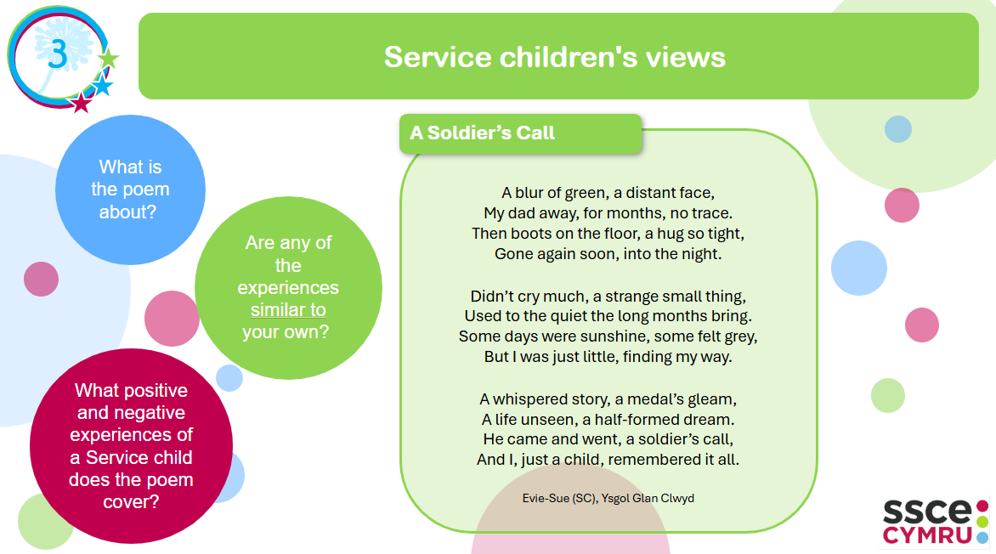
Notes:
(English) Activity: Hearing Service children's views - Print on A3. Print 2 copies per table.

Slide 2
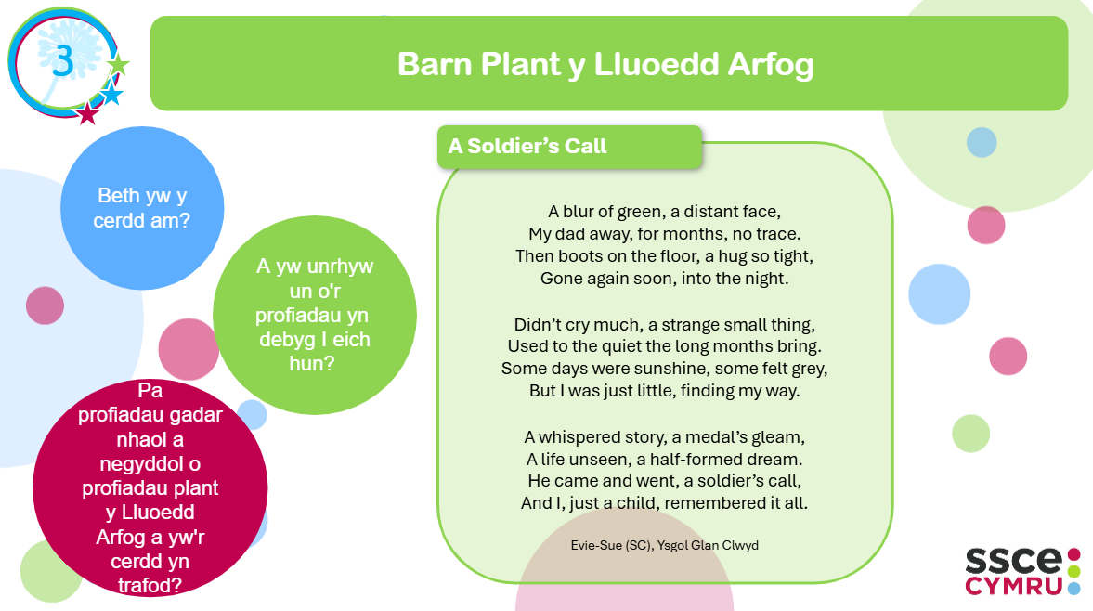
Notes:
(Welsh) Activity: Hearing Service children's views - Print on A3. Print 2 copies per table.

Slide 3
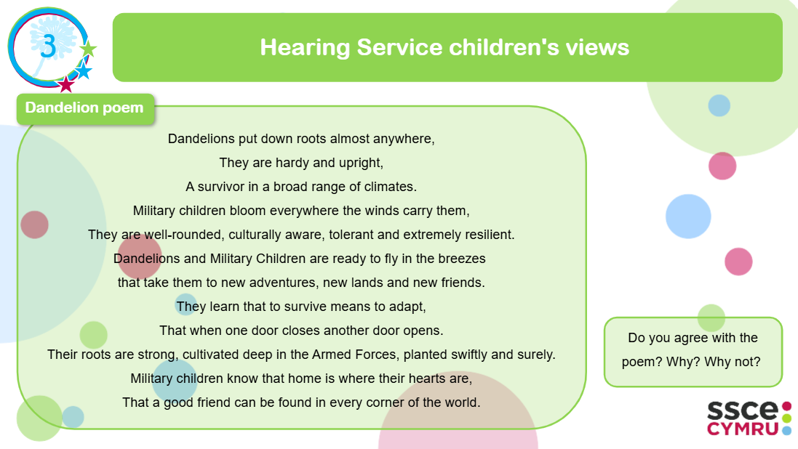
Notes:
(English) Activity: Hearing Service children's views - Print on A3. Print 2 copies per table.

Slide 4
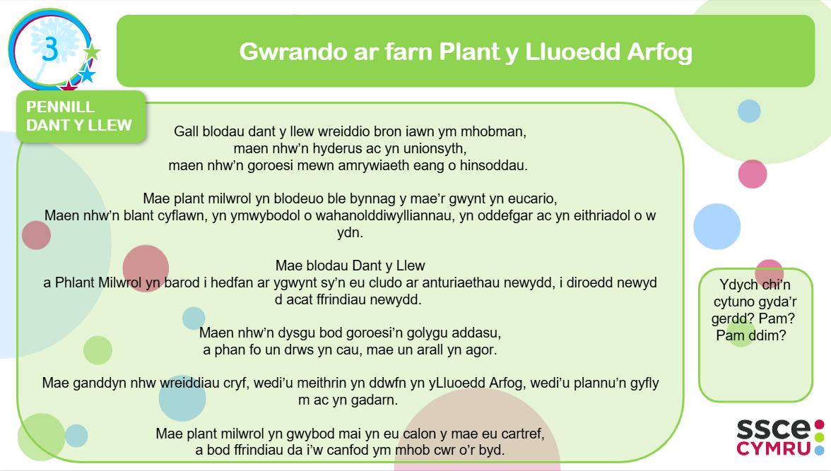
Notes:
(Welsh) Activity: Hearing Service children's views - Print on A3. Print 2 copies per table.

Slide 5


Pros and Cons: What are the advantages and disadvantages of being a 'Service child'?
4
Advantages
Disadvantages
Notes:
(English) Activity: Pros and cons - Print on A3. Print 2 copies per table

Slide 6
Manteision ac Anfanteision: Beth yw manteision ac anfanteision bod yn ‘blentyn y Lluoedd Arfog’?
4
Manteision
Anfanteision
Notes:
(Welsh) Activity: Pros and cons - Print on A3 – as required in Welsh?

Slide 7
Pros and Cons: What are the advantages and disadvantages of being a 'Service child'?
4
Advantages
New experiences and opportunities
Treats when your Armed Forces family member returns home
Experiencing different cultures
Special clubs in school e.g. Little Troopers / Forces Life clubs
Uniform, badges and medals – all make you feel proud
Friends – new friends, having friends in different places, making more friends.
Having more responsibility than civilian children
Armed Forces facilities e.g. being able to visit a base
Living in different places (in the UK and the world)
Builds resilience and mental strength
Attending special military events e.g. Remembrance
Military communities e.g. living on military estates means there are lots of other children to play with
Sharing skills e.g. Armed Forces family member sharing skills they’ve learnt from service
Military houses e.g. getting to live in different houses
Experience with Armed Forces equipment e.g. ration packs
Army welfare trips and events e.g. family events
Notes:
(English) Activity: Pros and Cons - Prompt - Print on A4. Print 2 copies per table

Slide 8
Manteision ac Anfanteision: Beth yw manteision ac anfanteision bod yn ‘blentyn y Lluoedd Arfog’?
4
Manteision
Profiadau a chyfleoedd newydd
'Goodies' pan fydd eich aelod Lluoedd Arfog o'r teulu yn dychwelyd adref
Profi gwahanol ddiwylliannau
Clybiau arbennig yn yr ysgol e.e. Clybiau Little Troopers / Bywyd Lluoedd
Gwisg, bathodynnau a medalau – mae pob un yn gwneud i chi deimlo'n falch
Ffrindiau – ffrindiau newydd, cael ffrindiau mewn gwahanol leoedd, gwneud mwy o ffrindiau.
Cael mwy o gyfrifoldeb na plant sifil
Cyfleusterau'r Lluoedd Arfog e.e. gallu ymweld â'r base
Byw mewn gwahanol leoedd (yn y DU a'r byd)
Adeiladu gwytnwch a meddyliol cryfder
Mynychu digwyddiadau milwrol arbennig e.e. Cofio
Cymunedau milwrol e.e. byw ar ystadau milwrol yn golygu bod yna. Mae llawer o blant eraill i'w chwarae gyda
Rhannu sgiliau e.e. Lluoedd Arfog Sgiliau rhannu aelodau o'r teulu maen nhw wedi dysgu o'r gwasanaeth
Tai milwrol e.e. cyrraedd byw mewn gwahanol dai
Profiad gyda'r Lluoedd Arfog offer e.e. pecynnau dogn
Teithiau a digwyddiadau lles y fyddin e.e. digwyddiadau teuluol
Notes:
(Welsh) Activity: Pros and Cons - Prompt - Print on A4. Print 2 copies per table

Slide 9
Pros and Cons: What are the advantages and disadvantages of being a 'Service child'?
4
Disadvantages
Armed Forces family members being away for long periods of time
Short notice when Armed Forces family members go away. Little time to prepare.
Worrying about your Armed Forces family member being in danger
Bossy parents who order you around (like you're in the military too)
Leaving houses, places, countries, schools etc you liked
Every time you say goodbye worrying it might be the last time
Friends – leaving, loosing and missing friends. No opportunities to keep in touch.
Difficulties bonding with parents as they are away when you are young.
Military houses – not being able to paint your bedroom
Missing or repeating learning at school
Sometimes hiding your emotions and feelings
Missing family e.g. Grandparents
Armed Forces family members missing special events e.g. Fathers Day, Christmas
Losing people close to you
Moving a lot
PTSD e.g. family members having had bad experiences that impact their sleep, what they can and can’t do and their mental health
Having to plan contact time
Feeling lonely and isolated
Notes:
(English) Activity: Pros and Cons - Prompt - Print on A4. Print 2 copies per table

Slide 10
Manteision ac Anfanteision: Beth yw manteision ac anfanteision bod yn ‘blentyn y Lluoedd Arfog’?
4
Anfanteision
Aelodau teulu'r Lluoedd Arfog bod i ffwrdd am gyfnodau hir o amser
Rhybudd byr pan fydd eich aelod o'r teulu sydd yn y Lluoedd Arfog yn mynd i ffwrdd. Ychydig o amser i baratoi
Poeni am eich aelod o'r teulu Lluoedd Arfog bod yn perygl
Rhieni 'bossy' sy'n eich gorchymyn chi o gwmpas (fel eich bod yn y fyddin hefyd)
Gadael tai, lleoedd, gwledydd, ysgolion ac ati roeddech chi'n eu hoffi
Bob tro y byddwch chi'n ffarwelio poeni efallai mai dyma'r tro olaf
Ffrindiau – gadael, colli a ffrindiau ar goll. Na cyfleoedd i gadw mewn cysylltiad.
Anawsterau bondio gyda rhieni gan eu bod i ffwrdd pan fyddwch chi ifanc.
Tai milwrol – methu â gallu i baentio'ch ystafell wely
Colli neu ailadrodd dysgu yn ysgol
Weithiau cuddio eich emosiynau a theimladau
Teulu ar goll e.e. Neiniau a theidiau
Aelodau teulu'r Lluoedd Arfog yn methu digwyddiadau arbennig e.e. Sul y Tadau, Nadolig
Colli pobl agos atoch chi
Symud lot
PTSD e.e. aelodau o'r teulu yn cael profiadau gwael sy'n effeithio ar eu cwsg, beth gallant ac ni allant wneud ac eu iechyd meddwl
Gorfod cynllunio amser cyswllt
Teimlo'n unig ac yn ynysig
Notes:
(Welsh) Activity: Pros and Cons - Prompt - Print on A4. Print 2 copies per table

Slide 11
5
What does your current / previous school/s do well to …
celebrate your Service child experiences / lives?
to support you as a Service child?
Notes:
(English) Activity: Celebrating Success - Print on A3. Print 2 copies per table.

Slide 12
Dathlu Llwyddiant
5
Beth mae’ch ysgol bresennol yn ei wneud yn dda, neu beth oedd eich ysgol / ysgolion blaenorol yn ei wneud yn dda…
1. i ddathlu profiadau / bywydau plant y Lluoedd Arfog?
2. i’ch cefnogi hi fel plentyn y Lluoedd Arfog?
Notes:
(Welsh) Activity: Celebrating Success - Print on A3. Print 2 copies per table.

Slide 13
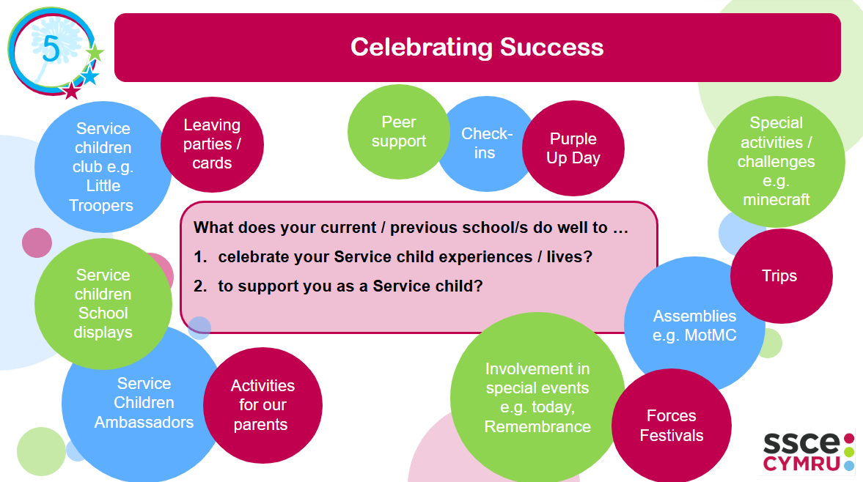
Notes:
(English) Activity: Celebrating Success - Print on A3. Print 2 copies per table.

Slide 14
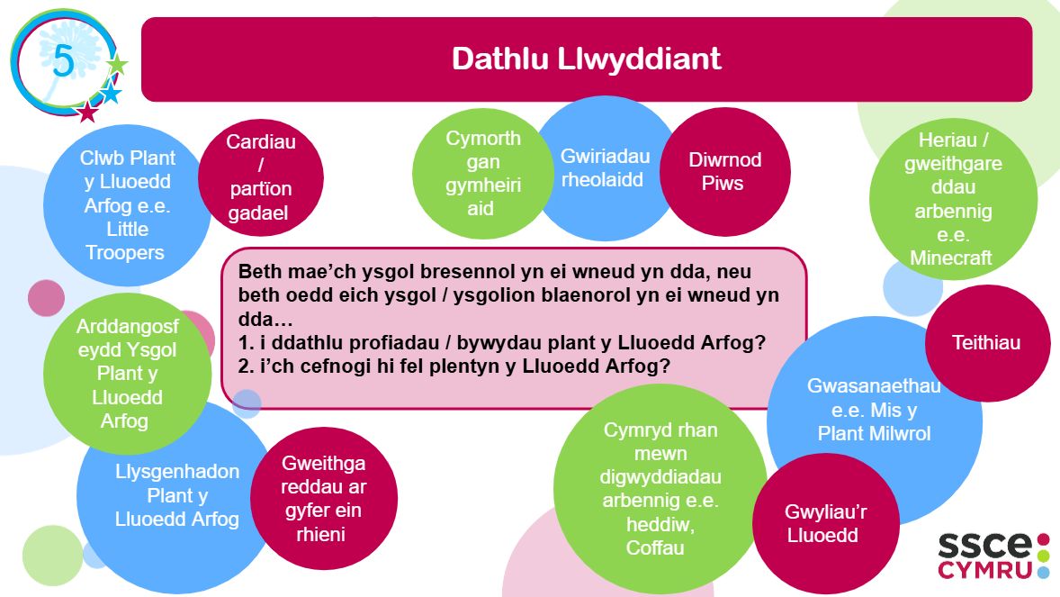
Notes:
(Welsh) Activity: Celebrating Success - Print on A3. Print 2 copies per table.

Slide 15
6
What are the main barriers/challenges for Service children in school? What could schools do to help overcome these?
Notes:
(English) Activity: Identifying and overcoming challenges - Print on A3. Print 2 copies per table.

Slide 16
6
Beth yw’r prif rwystrau /heriau ar gyfer Plant yLluoedd Arfog yn yr ysgol? Beth allai ysgolion ei wneud i’helpu i oresgyn y rhain?
Notes:
(Welsh) Activity: Identifying and overcoming challenges - Print on A3 – as required in Welsh?

Slide 17
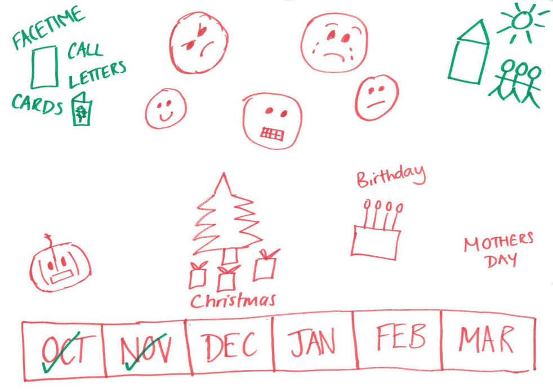
Notes:
Print on A4. Print 1 copy per table

Slide 18
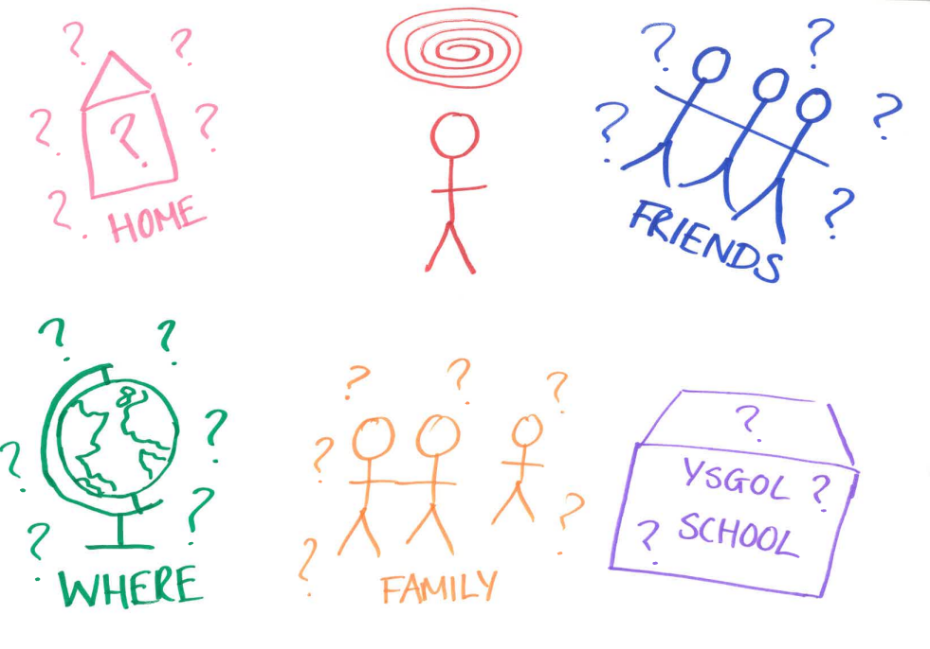
Notes:
Print on A4. Print 1 copy per table

Slide 19
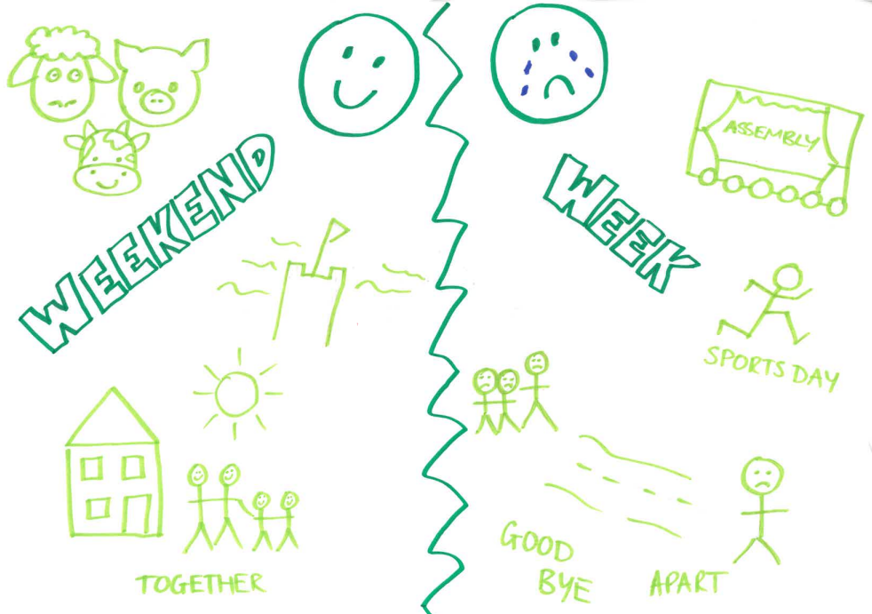
Notes:
Print on A4. Print 1 copy per table

