Slide 1

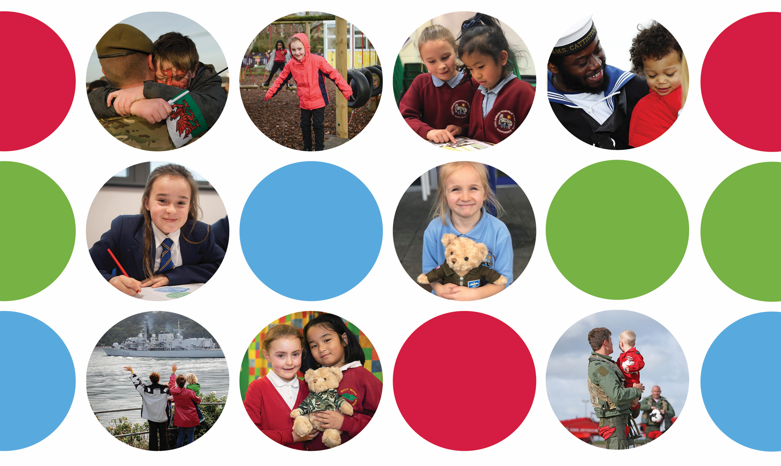
SSCE Cymru Service Pupil Promise - A structured approach to gathering Service children’s voices enabling the creation of a Local Authority Service Pupils’ Promise

Slide 2
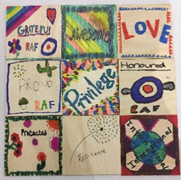


Settler: What are you most proud about being linked to the military?
1
What are you most proud about being linked to the military?
On your tile;
Draw an image depicting this
Add one word to summarise it
Be prepared to share with others what you have chosen / dran / written and why.
Notes:
10-20mins
OPTION 1: Mosaic tile creation
What are you most proud about being linked to the military?
Each child to draw an image on a 3 x 3-inch wooden square depicting this and add one word to summarise it
Each child to explain to the facilitator why they have chosen what they have – and share with table group
(The tiles can then be used to create a collage / mosaic, possibly using an outline shape. Whilst cardboard tiles can be used, the benefit of wooden tiles is that they are hardier and can be glued. If a child makes a mistake, the tiles can be turned over for a fresh start.)

Slide 3
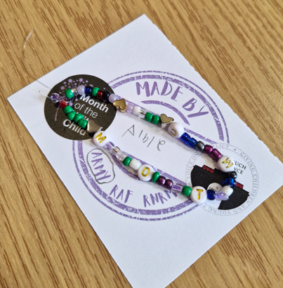
Settler: Friendship bracelet
1
Service children friendship bracelet
Create a Service children friendship bracelet using the beads provided.
Notes:
10-20mins
OPTION 2: Friendship bracelet making
Each child to choose their beads to make a bracelet, perhaps for the Month of the Military Child or for a special person.
Ask a friend or adult if help is needed tying it at the end.
If for a gift, children to write on it their first name and branch of the military their parent/guardian is in.

Slide 4
Welcome
2
Add welcome information e.g.
Image, role, key message from person opening the event.
Notes:
20mins -
Welcome to whole group
Introduction of schools
Table introductions – name, year group, link to the Armed Forces
Overview and aims of the day
Complete ‘Find a Friend’ bingo

Slide 5
Welcome
2
Welcome to Service children/young people and staff from the following schools;
Add names of school
Add names of school
Notes:
20mins -
Welcome to whole group
Introduction of schools
Table introductions – name, year group, link to the Armed Forces
Overview and aims of the day
Complete ‘Find a Friend’ bingo

Slide 6
Welcome
2
What is a Service Pupil Promise?
A Service Pupil Promise is a commitment from the Local Authority (Add name of LA) to support children from Armed Forces families. It links to the Armed Forces Covenant but rather than being about all of the family it is just about Service children.
How do we create a Service Pupil Promise?
To create a Service Pupil Promise the Local Authority firstly need to understand all of the unique experiences and challenges Service children might face e.g. mobility, separation, moving schools etc. To do this we need to work with you to listen to your voices and understand your experiences.
The promise will help ensure that Service children receive the recognition and tailored support they deserve. It will also strengthen the local authorities commitment to inclusion and the Armed Forces Covenant.
Notes:
20mins -
Welcome to whole group
Introduction of schools
Table introductions – name, year group, link to the Armed Forces
Overview and aims of the day
Complete ‘Find a Friend’ bingo

Slide 7
Welcome
2
Time | Agenda item | Topic | Who
 | Arrival & Welcome | Ice breaker, welcome speech, introductions, overview of the day
 | Hearing Service children's views | Add activity
 | Pros and cons | What are the advantages and disadvantages of being a ‘Service child’?
 | Celebrating success | What does your current school do well, or what did previous schools do well, to celebrate your Service child experiences / lives and to support you as a Service child?
 | Identifying and overcoming challenges | Add activity/ies
 | Improving provision | Add activity
 | Reflection | Add activity
 | Closing | Closing speech
Notes:
20mins -
Welcome to whole group
Introduction of schools
Table introductions – name, year group, link to the Armed Forces
Overview and aims of the day
Complete ‘Find a Friend’ bingo

Slide 8
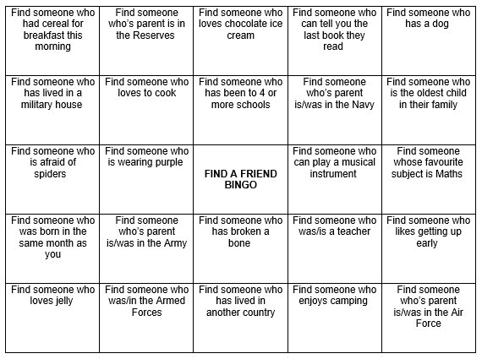
Icebreaker
2
Find a friend BINGO
Notes:
20mins -
Welcome to whole group
Introduction of schools
Table introductions – name, year group, link to the Armed Forces
Overview and aims of the day
Complete ‘Find a Friend’ bingo

Slide 9
Service children's views
3
What is the poem about?
A Soldier’s Call
A blur of green, a distant face,
My dad away, for months, no trace.
Then boots on the floor, a hug so tight,
Gone again soon, into the night.
Didn’t cry much, a strange small thing,
Used to the quiet the long months bring.
Some days were sunshine, some felt grey,
But I was just little, finding my way.
A whispered story, a medal’s gleam,
A life unseen, a half-formed dream.
He came and went, a soldier’s call,
And I, just a child, remembered it all.
Evie-Sue (SC), Ysgol Glan Clwyd
Are any of the experiences similar to your own?
What positive and negative experiences of a Service child does the poem cover?
Notes:
10-15mins -
OPTION 1: NSI Winner A Soldier’s Call Poem
We will start today's session by looking at a poem, 'A Soldier's Call' written by a Service child, Evie-Sue, in North Wales. The Poem was one of the winners of the Never Such Innocence Month of the Military Child competition 2025. Read the poem and in your groups discuss;
What is the poem about?
Are any of the experiences similar to your own?
What positive and negative experiences of Service children does this poem cover?
Printable copy of poem 'A Solider's Call'

Slide 10
Hearing Service children's views
3
Service children videos
Watch the videos. Discuss and reflect.
Add links / embed videos.
Notes:
10-15mins -
OPTION 2: Listening to others
Watch a couple of short videos from SSCE website
SSCE Cymru :: Service children film and discuss / reflect.

Slide 11
Hearing Service children's views
3
Dandelion poem
Dandelions put down roots almost anywhere,
They are hardy and upright,
A survivor in a broad range of climates.
Military children bloom everywhere the winds carry them,
They are well-rounded, culturally aware, tolerant and extremely resilient.
Dandelions and Military Children are ready to fly in the breezes
that take them to new adventures, new lands and new friends.
They learn that to survive means to adapt,
That when one door closes another door opens.
Their roots are strong, cultivated deep in the Armed Forces, planted swiftly and surely.
Military children know that home is where their hearts are,
That a good friend can be found in every corner of the world.
Do you agree with the poem? Why? Why not?
Notes:
10-15mins -
OPTION 3: Dandelion Poem
Adults to read the Dandelion Poem – a line from each adult spread across the room is particularly powerful. Pupils discuss this – do they agree with it?
Printable copy of Dandelion Poem

Slide 12
Pros and Cons: What are the advantages and disadvantages of being a 'Service child'?
4
RAF
What branch of the Armed Forces is your Armed Forces family member in?
Army
Royal Navy
Notes:
30mins -
Vote with your feet (movement activity) linked to advantages and disadvantages.

Slide 13
Pros and Cons: What are the advantages and disadvantages of being a 'Service child'?
4
Currently Serving
What is your connection to the Armed services ?
Veteran
Reservist
Notes:
30mins -
Vote with your feet (movement activity) linked to advantages and disadvantages.

Slide 14
Pros and Cons: What are the advantages and disadvantages of being a 'Service child'?
4
Separation
–
Operational tour
Which of these experiences are you most drawn to?
Separation
- Weekending
Separation –
Exercise / courses
Post Service life – Remembrance, forever home etc
Moving – new house, new school
Notes:
30mins -
Vote with your feet (movement activity) linked to advantages and disadvantages.
Which of these experiences are you most drawn to?
Why? What are/were the advantages and challenges of this/these experience/s?
Ask a select number of SC to share.
Is there anyone else who can relate to this?

Slide 15
Pros and Cons: What are the advantages and disadvantages of being a 'Service child'?
4
Separation
–
Operational tour
Which of these experiences are you most drawn to?
Separation
- Weekending
Separation –
Exercise / courses
Post Service life – Remembrance, forever home etc
Moving – new house, new school
Why?
What are/were the advantages and/or challenges of these experience/s
Notes:
30mins -
Vote with your feet (movement activity) linked to advantages and disadvantages.
Which of these experiences are you most drawn to?
Why? What are/were the advantages and challenges of this/these experience/s?
Ask a select number of SC to share.
Is there anyone else who can relate to this?

Slide 16
Pros and Cons: What are the advantages and disadvantages of being a 'Service child'?
4
Using the post-it notes provided / On your mind map record as many advantages and disadvantages as you can.
Choose the 3 most significant advantages and 3 most significant disadvanges.
Stick these to the large sheets of paper for display at the front / board (next slide if displayed)
Be ready to discuss your choices.
Notes:
30mins -
Think, pair, share on tables
2 colours of Post-It notes / pens to record as many advantages and disadvantages as you can.
Each table, supported by facilitator, to choose the 3 most important advantages and 3 most significant disadvantages.
Stick these on the large sheets for display at front.
Discuss similarities / differences between the groups.

Slide 17
Pros and Cons: What are the advantages and disadvantages of being a 'Service child'?
4
Advantages
Disadvantages
Notes:
30mins -
Display on board. Service children to stick their 3 most important advantages and 3 most significant disadvantages to the board.
Discuss similarities / differences between the groups.

Slide 18
Pros and Cons: What are the advantages and disadvantages of being a 'Service child'?
4
Advantages
New experiences and opportunities
Treats when your Armed Forces family member returns home
Experiencing different cultures
Special clubs in school e.g. Little Troopers / Forces Life clubs
Uniform, badges and medals – all make you feel proud
Friends – new friends, having friends in different places, making more friends.
Having more responsibility than civilian children
Armed Forces facilities e.g. being able to visit a base
Living in different places (in the UK and the world)
Builds resilience and mental strength
Attending special military events e.g. Remembrance
Military communities e.g. living on military estates means there are lots of other children to play with
Sharing skills e.g. Armed Forces family member sharing skills they’ve learnt from service
Military houses e.g. getting to live in different houses
Experience with Armed Forces equipment e.g. ration packs
Army welfare trips and events e.g. family events
Notes:
30mins
Prompt cards
Printable copy of Pros cards (examples taken from Pembrokeshire SC Voice pre-event. Cards can also be edited)

Slide 19
Pros and Cons: What are the advantages and disadvantages of being a 'Service child'?
4
Disadvantages
Armed Forces family members being away for long periods of time
Short notice when Armed Forces family members go away. Little time to prepare.
Worrying about your Armed Forces family member being in danger
Bossy parents who order you around (like you're in the military too)
Leaving houses, places, countries, schools etc you liked
Every time you say goodbye worrying it might be the last time
Friends – leaving, loosing and missing friends. No opportunities to keep in touch.
Difficulties bonding with parents as they are away when you are young.
Military houses – not being able to paint your bedroom
Missing or repeating learning at school
Sometimes hiding your emotions and feelings
Missing family e.g. Grandparents
Armed Forces family members missing special events e.g. Fathers Day, Christmas
Losing people close to you
Moving a lot
PTSD e.g. family members having had bad experiences that impact their sleep, what they can and can’t do and their mental health
Having to plan contact time
Feeling lonely and isolated
Notes:
30mins
Prompt cards
Printable copy of Cons cards (examples taken from Pembrokeshire SC Voice pre-event. Cards can also be edited)

Slide 20
Celebrating Success
5
What does your current / previous school/s do well to celebrate your Service child experiences / lives?
What does your current / previous school/s do well to support you as a Service child?
Discuss with a partner / small group.
Share ideas with your table.
Notes:
15mins -
Discuss with a partner / small group & then share ideas with table.
Facilitator to record on a big sheet or paper divided into 2: celebrate/support. Blu-tac up for all to see.
Elicit further information e.g. if SC mention SC clubs then find out what they do in the clubs, why they like them etc. If SC mention MotMC celebrations find out what their schools have done to celebrate this.

Slide 21
Celebrating Success
5
Peer support
Service children club e.g. Little Troopers
Leaving parties / cards
Check-ins
Purple Up Day
Special activities / challenges e.g. minecraft
What does your current / previous school/s do well to …
celebrate your Service child experiences / lives?
to support you as a Service child?
Service children School displays
Trips
Assemblies e.g. MotMC
Involvement in special events e.g. today, Remembrance
Service Children Ambassadors
Activities for our parents
Forces Festivals
Notes:
15mins -
Prompt slide. This slide gives some examples of what schools may do that could be discussed. Discuss with a partner / small group & then share ideas with table.
Facilitator to record on a big sheet or paper divided into 2: celebrate/support. Blu-tac up for all to see.
Elicit further information e.g. if SC mention SC clubs then find out what they do in the clubs, why they like them etc. If SC mention MotMC celebrations find out what their schools have done to celebrate this.

Slide 22
Identifying and overcoming challenges
6
Think back to the poem
What are the main barriers/challenges for Service children in school?
Discuss this question as a group.
Write each example of a barrier and/or challenges on a post-it.
When told come and place these on the board.
Think back to the disadvantages
Notes:
30-60mins (based on activities included) -
What are the main barriers/challenges for Service children in school?
List these on Post-it notes / create a mind map – detailing any barriers and challenges. Service children can link these to the disadvantages earlier activity. Display on a central board You may find it helpful to use different colour pens for each barrier / challenge. (10 mins)

Slide 23
Identifying and overcoming challenges
6
What could schools do to help overcome your barrier/challenge?
Each table has been given a different barrier / challenge to discuss.
Create a spider diagram of your ideas on how this barrier/challenge could be overcome.
Notes:
30-60mins (based on activities included) -
What could schools do to help overcome this barrier/challenge?
Each table group is then allocated a different issue / challenge:
Large sheet of paper per table. Children record all ideas as a spider diagram (10 mins)
Rotate around tables a couple of times so others can add additional ideas/solutions (10 mins)

Slide 24
6
What could schools do to help overcome your barrier/challenge?
Notes:
Print copies on A3 for table discussions

Slide 25
Identifying and overcoming challenges
6
"It's difficult to understand what it's like to be a Service child when you haven't been one yourself."
"We moved Christmas so my dad could have it with us."
Lack of understanding
Separation
Moving
"My sister didn't really know or bond with my dad because he was away."
"It's hard moving around a lot."
"If adults haven't had any experience then they don't understand how it feels."
"Education suffers because we move."
Notes:
30-60mins (based on activities included) -
ADDITIONAL ACTIVITIES
Discuss common barriers/challenges e.g.
Lack of Understanding
Separation
Moving, settling and forever

Slide 26
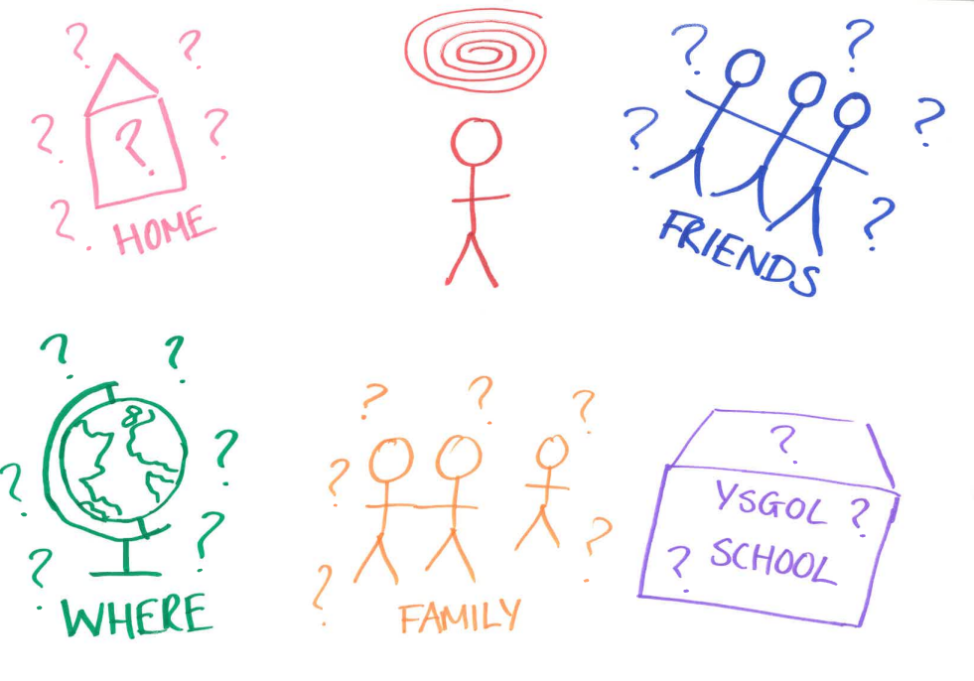
Identifying and overcoming challenges
6
Moving – the unknown
Notes:
30-60mins (based on activities included) -
ADDITIONAL ACTIVITIES - OPTION 1: Big Empathy Drawings
Big Empathy Drawings can be used to explore underlying emotional themes/core feelings through drawing. More information can be found here.
Display example big empathy drawing/s on the board. Explain what a big empathy drawing is linking to the example drawing/s commenting on how the person who created this drawing might have felt. (It is beneficial to have a facilitator with their own experience talk about their own big empathy drawing here).
Individual Service children create a big empathy drawing based on a key challenge they have experienced as a Service child e.g.
Separation – weekending, deployment, exercise, from other family/friends
Moving, settling and forever – the unknown, new home, school, location, friends, when will it happen
Veteran – what is a veteran, ‘being military connected, how does it make you feel, PTSD
Printable copies of Big Empathy drawings

Slide 27
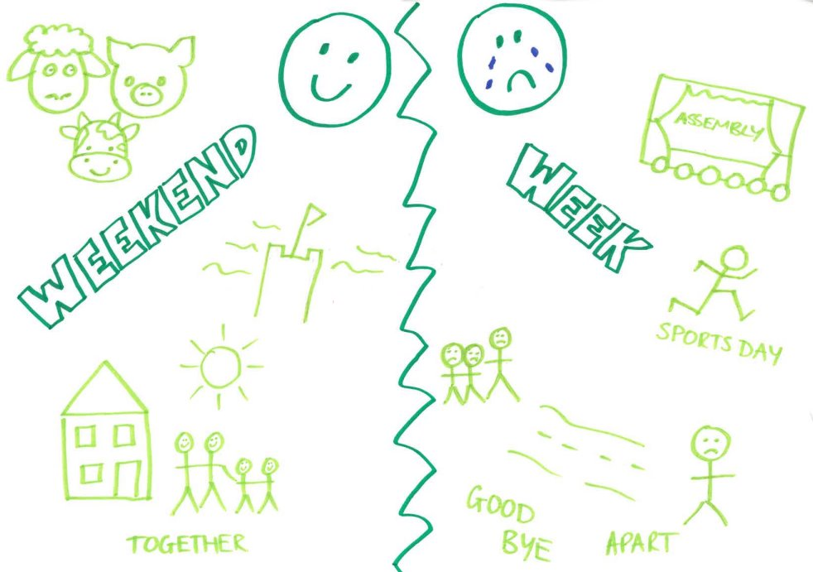
Identifying and overcoming challenges
6
Separation - Weekending
Notes:
30-60mins (based on activities included) -
ADDITIONAL ACTIVITIES - OPTION 1: Big Empathy Drawings
Big Empathy Drawings can be used to explore underlying emotional themes/core feelings through drawing. More information can be found here.
Display example big empathy drawing/s on the board. Explain what a big empathy drawing is linking to the example drawing/s commenting on how the person who created this drawing might have felt. (It is beneficial to have a facilitator with their own experience talk about their own big empathy drawing here).
Individual Service children create a big empathy drawing based on a key challenge they have experienced as a Service child e.g.
Separation – weekending, deployment, exercise, from other family/friends
Moving, settling and forever – the unknown, new home, school, location, friends, when will it happen
Veteran – what is a veteran, ‘being military connected, how does it make you feel, PTSD
Printable copies of Big Empathy drawings

Slide 28
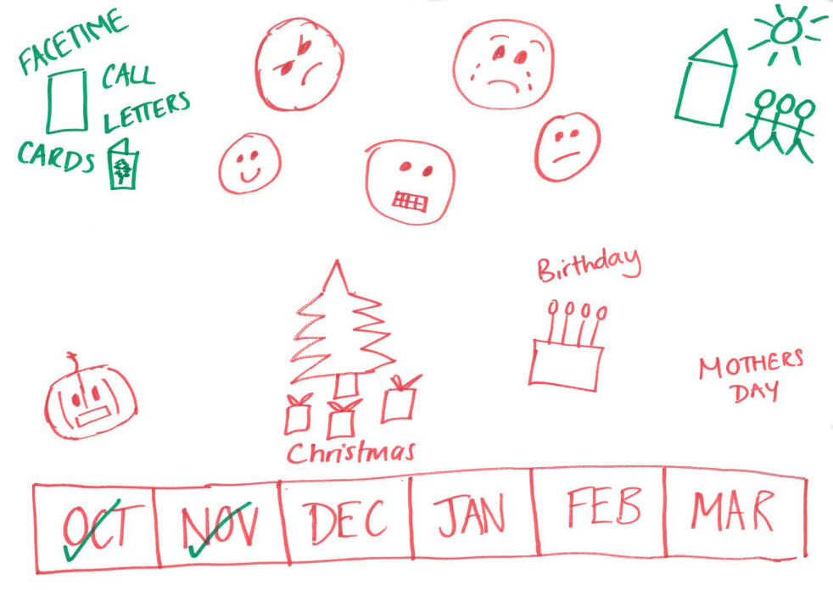
Identifying and overcoming challenges
6
Separation - Deployment
Notes:
30-60mins (based on activities included) -
ADDITIONAL ACTIVITIES - OPTION 1: Big Empathy Drawings
Big Empathy Drawings can be used to explore underlying emotional themes/core feelings through drawing. More information can be found here.
Display example big empathy drawing/s on the board. Explain what a big empathy drawing is linking to the example drawing/s commenting on how the person who created this drawing might have felt. (It is beneficial to have a facilitator with their own experience talk about their own big empathy drawing here).
Individual Service children create a big empathy drawing based on a key challenge they have experienced as a Service child e.g.
Separation – weekending, deployment, exercise, from other family/friends
Moving, settling and forever – the unknown, new home, school, location, friends, when will it happen
Veteran – what is a veteran, ‘being military connected, how does it make you feel, PTSD
Printable copies of Big Empathy drawings

Slide 29
Identifying and overcoming challenges
6
Create / edit a drawing on one of the following themes:
Separation
Moving, Settling and Forever
Veteran
Separation
Moving, settling and forever
For the theme of separation you could create your drawing around one of these sub-categories;
Weekending
Deployment
Exercise
Courses
Other family / friends
For the theme of moving, settling and forever you may wish to include the experiences of
The unknown
New home
New school
New location
New friends
When will it happen
Veteran
For the theme of Veterans you may wish to include information on;
What is a Veteran?
Being military connect, how does it make you feel?
Notes:
30-60mins (based on activities included) -
ADDITIONAL ACTIVITIES - OPTION 1: Big Empathy Drawings
Big Empathy Drawings can be used to explore underlying emotional themes/core feelings through drawing. More information can be found here.
Display example big empathy drawing/s on the board. Explain what a big empathy drawing is linking to the example drawing/s commenting on how the person who created this drawing might have felt. (It is beneficial to have a facilitator with their own experience talk about their own big empathy drawing here).
Individual Service children create a big empathy drawing based on a key challenge they have experienced as a Service child e.g.
Separation – weekending, deployment, exercise, from other family/friends
Moving, settling and forever – the unknown, new home, school, location, friends, when will it happen
Veteran – what is a veteran, ‘being military connected, how does it make you feel, PTSD
Printable copies of Big Empathy drawings

Slide 30
Identifying and overcoming challenges
6
Assembly
Plan an Assembly to be delivered in schools to explain what life is like as Service child. This assembly should help address the barriers and challenges you have identified e.g. lack of understanding, separation, moving etc. You may wish to consider sections such as;
Notes:
30-60mins (based on activities included) -
ADDITIONAL ACTIVITIES - OPTION 2: Assembly
Plan an Assembly to be delivered in schools to explain what life is like as Service child. This assembly should help address lack of understanding as well as cover challenges such as separation, moving etc.
You could consider using content from SSCE Cymru Tool 11. TEMPLATE: Service children experience presentation

Slide 31
Identifying and overcoming challenges
6
Video
Record video clips of Service children reflecting on life as a Service child. All previous activities could be reflected upon e.g. pros and cons, school successes, barriers and challenges.
Notes:
30-60mins (based on activities included) -
ADDITIONAL ACTIVITIES - OPTION 3: Video
Record video clips of Service children reflecting on life as a Service child. All previous activities could be reflected upon e.g. pros and cons, school successes, barriers and challenges.

Slide 32
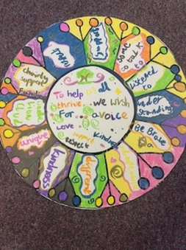
Improving provision School / Group Pledge
7
Create a group / school pledge. Consider the following questions:
How can your school support Service children even more during times of parental separation?
How can your school support Service children moving into or leaving the school even more than it currently does?
How can your school make sure that Service children's unique identities are recognised and celebrated?
Any other things you think your school should do to support Service children?
Following your discussion create a school/group pledge. Write this in the centre of the Dandelion template. Record your ideas for fulfilling it on the outside.
Add finishing touches e.g. doodles, decorations, symbols etc to represent the group's identity.
Notes:
20-30mins -
Creating a group (or school) pledge
Each group’s staff member leads a discussion with his / her group of Service pupils reflecting on the learning from the whole workshop.
Consider the following questions:
How can our school support Service children even more during times of parental separation?
How can our school support Service children moving into or leaving the school even more than it currently does?
How can our school make sure that Service children’s unique identities are recognised and celebrated?
Any other things you think our school should do to support SC?
From this discussion, create a group (or school) pledge. Write down your pledge. Separately record ideas for fulfilling it.
This could be presented in different ways e.g.
Dandelion (pledge in centre, ideas for fulfilling pledge and petals
Giant hands
Tree and leaves
Shield
Scroll / Charter
Work collaboratively to add finishing touches / doodles / decorations using bright colours, designs and symbols to represent the group’s identity.
Example of a school pledge (Primary)
Example of a school pledge (Secondary)

Slide 33
Reflection: 'Should schools treat Service children any differently to other pupils?'
8
YES
NO
SOMETIMES
Notes:
10mins -
‘Should schools treat Service children any different to other pupils?’
Invite pupils to vote on one of the following options: Y/N/sometimes. Depending on venue could vote with feet moving to different areas of the room. Take feedback.

Slide 34
Reflection: 'I wish my … knew ...'
8
I wish my … knew ...
Dad
Friend
Teacher
School
Mum
Notes:
10mins -

Slide 35

Reflection: 'Should schools treat Service children any differently to other pupils?'
8
What have we learnt today?
What would you like to happen as a result of today?
Write a short letter or postcard outlining your key points.
Notes:
10mins -
If not completed previously this could be done now.
A request to our head teacher or the Council
School staff members to lead a discussion on the key learning from today. Each child then invited to identify 1 or 2 things that they would like to happen as a result from today, writing these in a short letter on a postcard with relevant illustrations.
Postcards to be collected in as these can feed into an LA ‘Promise’.
Postcard template

Slide 36

Feedback of the day
1. What school do you go to?
2. What year group are you in?
3. What did you think of the day?
It was Amazing
It was good
It was ok
I didn’t enjoy it
It didn’t enjoy it at all
4. What was your favourite activity
and why?
5. If you had chance to do the day again what would you change, if anything?
6. Would you be interested in being a Service child Ambassador?
Yes
No
Notes:
5-10mins -
Circulate feedback forms to be completed before Service children leave.
Printable Feedback forms

