Slide 1
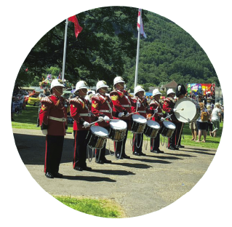
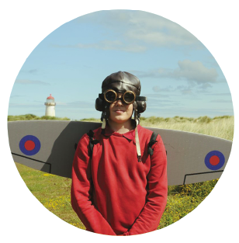
SSCE Cymru overview film available here

Slide 2
*NAME*
*JOB TITLE*

Slide 3
Notes:
A video providing a brief overview of the role of SSCE Cymru!
NOTE: an interest connection is required for this video to play.

Slide 4
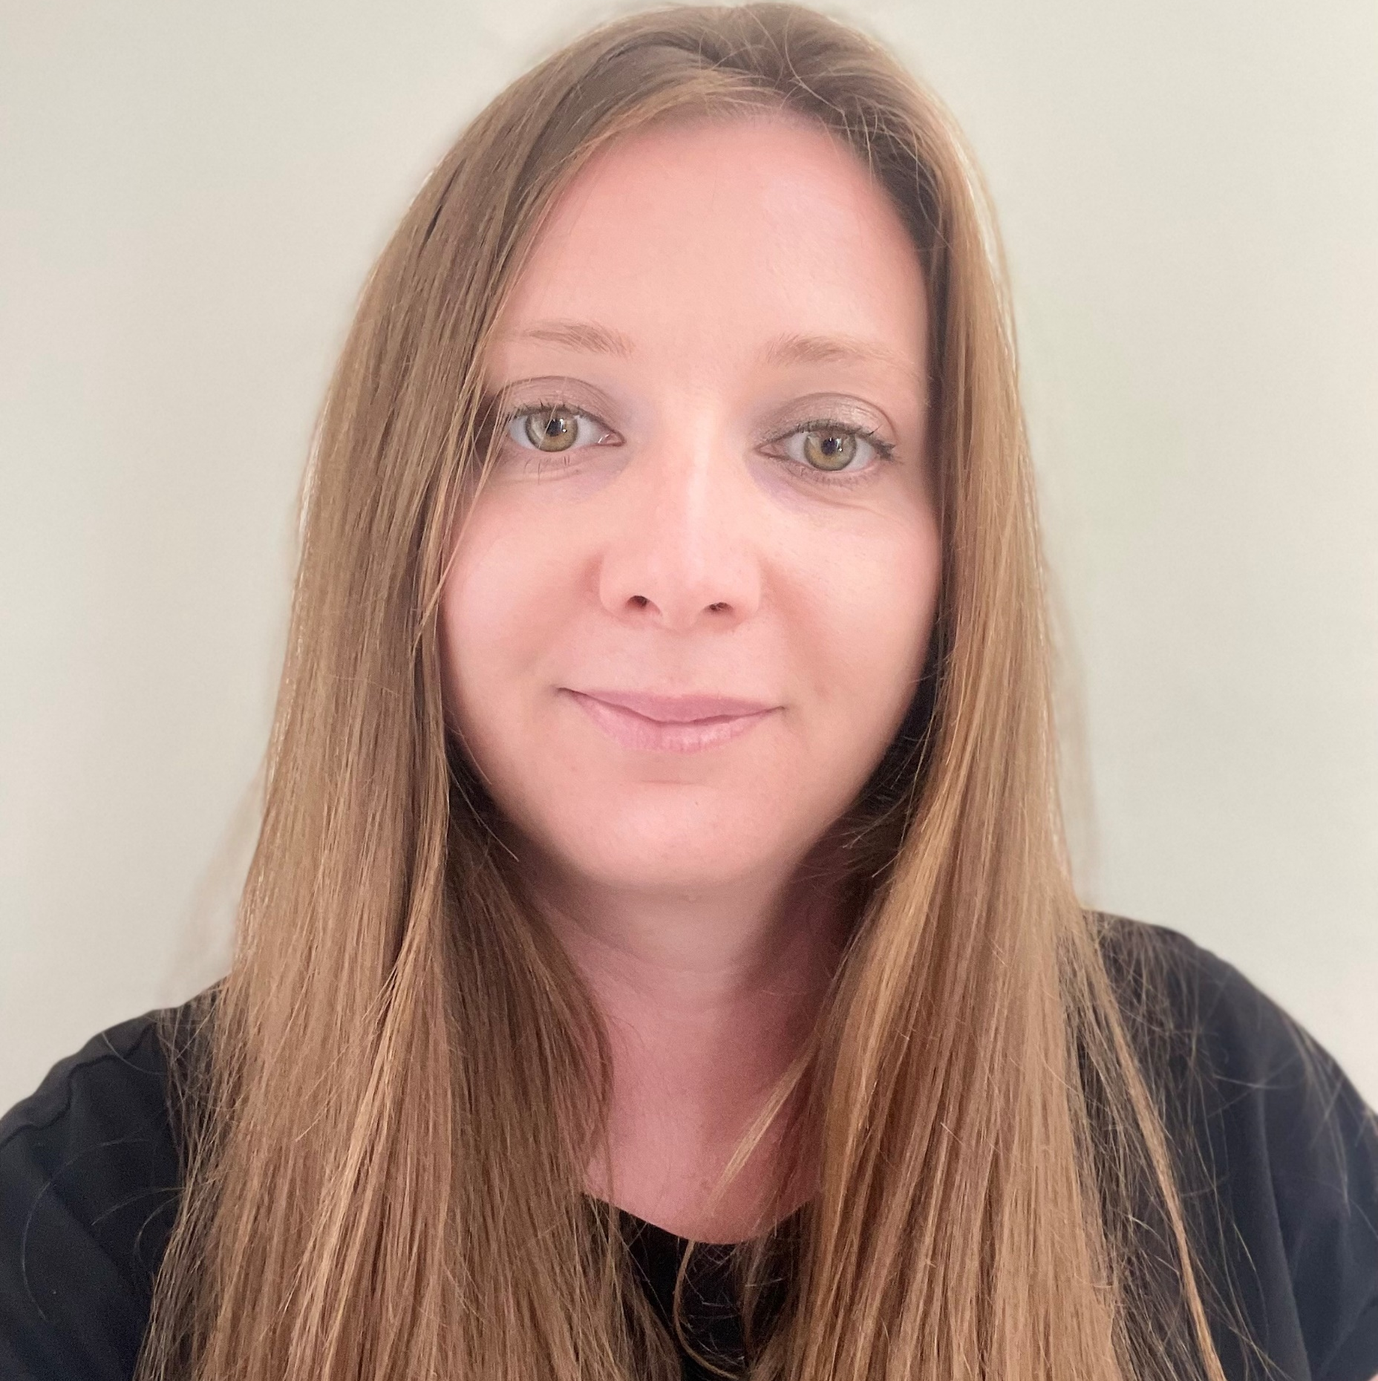
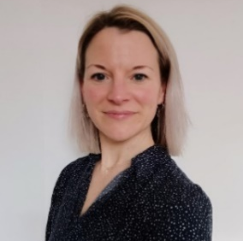
SSCE Cymru team
Programme Manager
School Liaison Officers
Participation Lead Officer
- Coordinates and delivers SSCE Cymru activities aligned to the SSCE Cymru mission.
- Ensures Service children’s experiences are understood and responded to in Wales.
- Represents Wales to share good practice across the UK.
- Work with schools and local authorities to identify Service children and maintain a database of school contacts.
- Promote the SSCE Cymru e-learning package.
- Work with education settings to embed support for Service children:
Utilise SSCE Cymru resources (School Toolkit and Tools, Funding guidance)
Achieve their Armed Forces Friendly Schools Cymru status
Celebrate Month of the Military Child
Access funding to support Service children and families.
Identify and promote good practice in schools.
SLOs are funded by:
Works with schools to:
Listen to Service children
Set up Service children clubs
Facilitate opportunities for Service children to come together to share their experiences
Celebrate Service children’s experiences
Share the voices of Service children.
Millie
Cara
Becca
Jo
Contact: SSCECymru@wlga.gov.uk

Slide 5
Tîm SSCE Cymru
Rheolwr Rhaglen
Swyddogion Cyswllt Ysgolion
Swyddog Arweiniol Cyfranogiad
- Cydlynu a darparu gweithgareddau SSCE Cymru sy'n cyd-fynd â chenhadaeth SSCE Cymru.
- Sicrhau bod profiadau plant Milwyr yn cael eu deall a'u hateb yng Nghymru.
- Yn cynrychioli Cymru i rannu arfer da ar draws y DU.
- Gweithio gydag ysgolion ac awdurdodau lleol i adnabod plant Milwyr a chynnal cronfa ddata o gysylltiadau ysgol.
- Hyrwyddo pecyn e-ddysgu SSCE Cymru.
- Gweithio gyda lleoliadau addysg i wreiddio cefnogaeth i blant Milwyr:
Defnyddio adnoddau SSCE Cymru (Pecyn Cymorth ac Offer i Ysgolion, Canllawiau ariannu)
Cyflawni eu statws Ysgolion sy'n Cefnogi'r Lluoedd Arfog Cymru
Dathlu Mis y Plentyn Milwrol
Mynediad at gyllid i gefnogi plant a theuluoedd y Lluoedd Arfog.
Adnabod a hyrwyddo arferion da mewn ysgolion.
Mae'r SLOs yn cael eu hariannu gan:
Gweithio gydag ysgolion i:
Gwrando ar blant Milwyr
Sefydlu clybiau plant Milwyr
Hwyluso cyfleoedd i blant milwyr ddod at ei gilydd i rannu eu profiadau
Dathlu profiadau plant Milwyr
Rhannu lleisiau plant Milwyr.
Millie
Cara
Becca
Jo
Cysylltwch â: SSCECymru@wlga.gov.uk

Slide 6
Welcome Becca…
“Hi, I’m Becca and will be working with the SSCE Cymru team as a
School Liaison Officer (SLO).
I have a background in Teaching and Additional Learning Needs
previously working as a specialist in this field in schools in England.
As mother of a Service child, I have first-hand experience of Armed
Forces life and have moved to Wales this Summer following my husband’s posting in the Army.
I am really excited to be joining the team and am looking forward to working on projects to further support Service children across Wales.”
Becca
School Liaison Officer

Slide 7
Further information here
SSCE Cymru Seren of the month
This is an opportunity for our team to publicly recognise an SSCE Cymru STAR, and say thank you to a Service child, member of school staff, work colleague, network member or organisation that have positively collaborated with us or shown exceptional support to Service children in education and their local Armed Forces community. We are grateful to work with some truly inspiring individuals and groups who ensure that Service children continue to feel valued and celebrated here in Wales.
Notes:
First Seren of the month was awarded in Sep23.

Slide 8
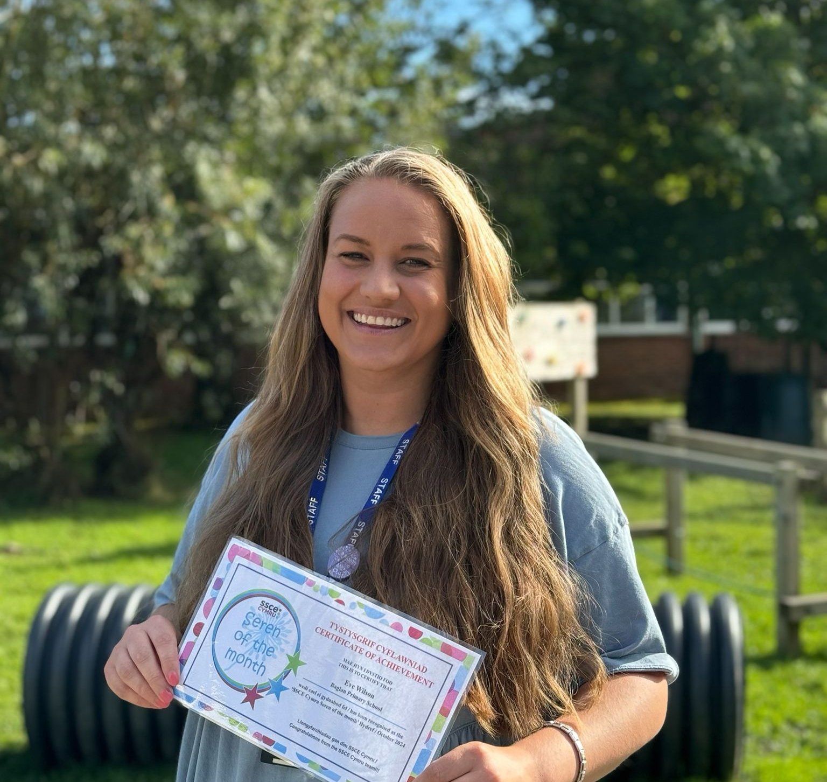
SSCE Cymru Seren of the month
Seren of the month – October 2024
It’s been wonderful to work alongside Eve at Baglan Primary School in Neath Port Talbot. When asked to take the lead on identifying and supporting Service children in the school, Eve contacted the SSCE Cymru team, and we were able to offer her advice and support on how to make a start. Since then, Eve has been very motivated and proactive. By applying for the Supporting Service Children in Education in Wales Fund (SSCE-WF), Eve set up a Little Troopers Club and now runs regular sessions throughout the academic year, bringing these children together from across all age groups. The Little Troopers Club members also appointed a Service child ambassador to represent their school for any SSCE Cymru activities outside of their normal sessions. As a result of listening to the Little Troopers, last year Eve organised a Remembrance assembly with the Service children, as a whole school event. They invited the Mayor and other members of the local community who share a connection to the Armed Forces and the event was a great success! Eve has continued to develop the schools support and has embedded good practice by working through the Armed Forces Friendly School (AFFS) Cymru checklist. The school has been awarded their GOLD status and are an excellent example of how a school with not large numbers of Service children can still make a huge difference. Thank you, Eve and the Baglan Primary team for all that you do within your community. Please keep up the good work!
Eve Wilson Baglan Primary School

Slide 9
Further information here
Armed Forces Friendly Schools Cymru
OBJECTIVES
CRITERIA THEMES
1. Embed good practice for supporting Service children
IDENTIFY
Service children and a key member of staff
2. Create a positive environment for Service children to share their experiences
UNDERSTAND
Service children and their individual needs
3. Encourage schools to become more engaged with their Armed Forces community.
ENGAGE
With SSCE Cymru and the Armed Forces community.
The SSCE Cymru team will work closely with all schools to support them in achieving their status, through completing activities/actions on the SSCE Cymru School checklist.

Slide 10
Further information here
Congratulations to all schools who have achieved their Armed Forces Friendly Schools Cymru status. So far, 30 schools have achieved their AFFS Cymru status. 31 have achieved Bronze, 7 have achieved Silver and 4 have achieved Gold!!!
This month, we are pleased to congratulate the following schools for achieving their AFFS Cymru status: Bronze: Raglan VC Primary School (Monmouthshire)
31
7
4
Notes:
The 26 AFFS’s come from 13 LAs.

Slide 11
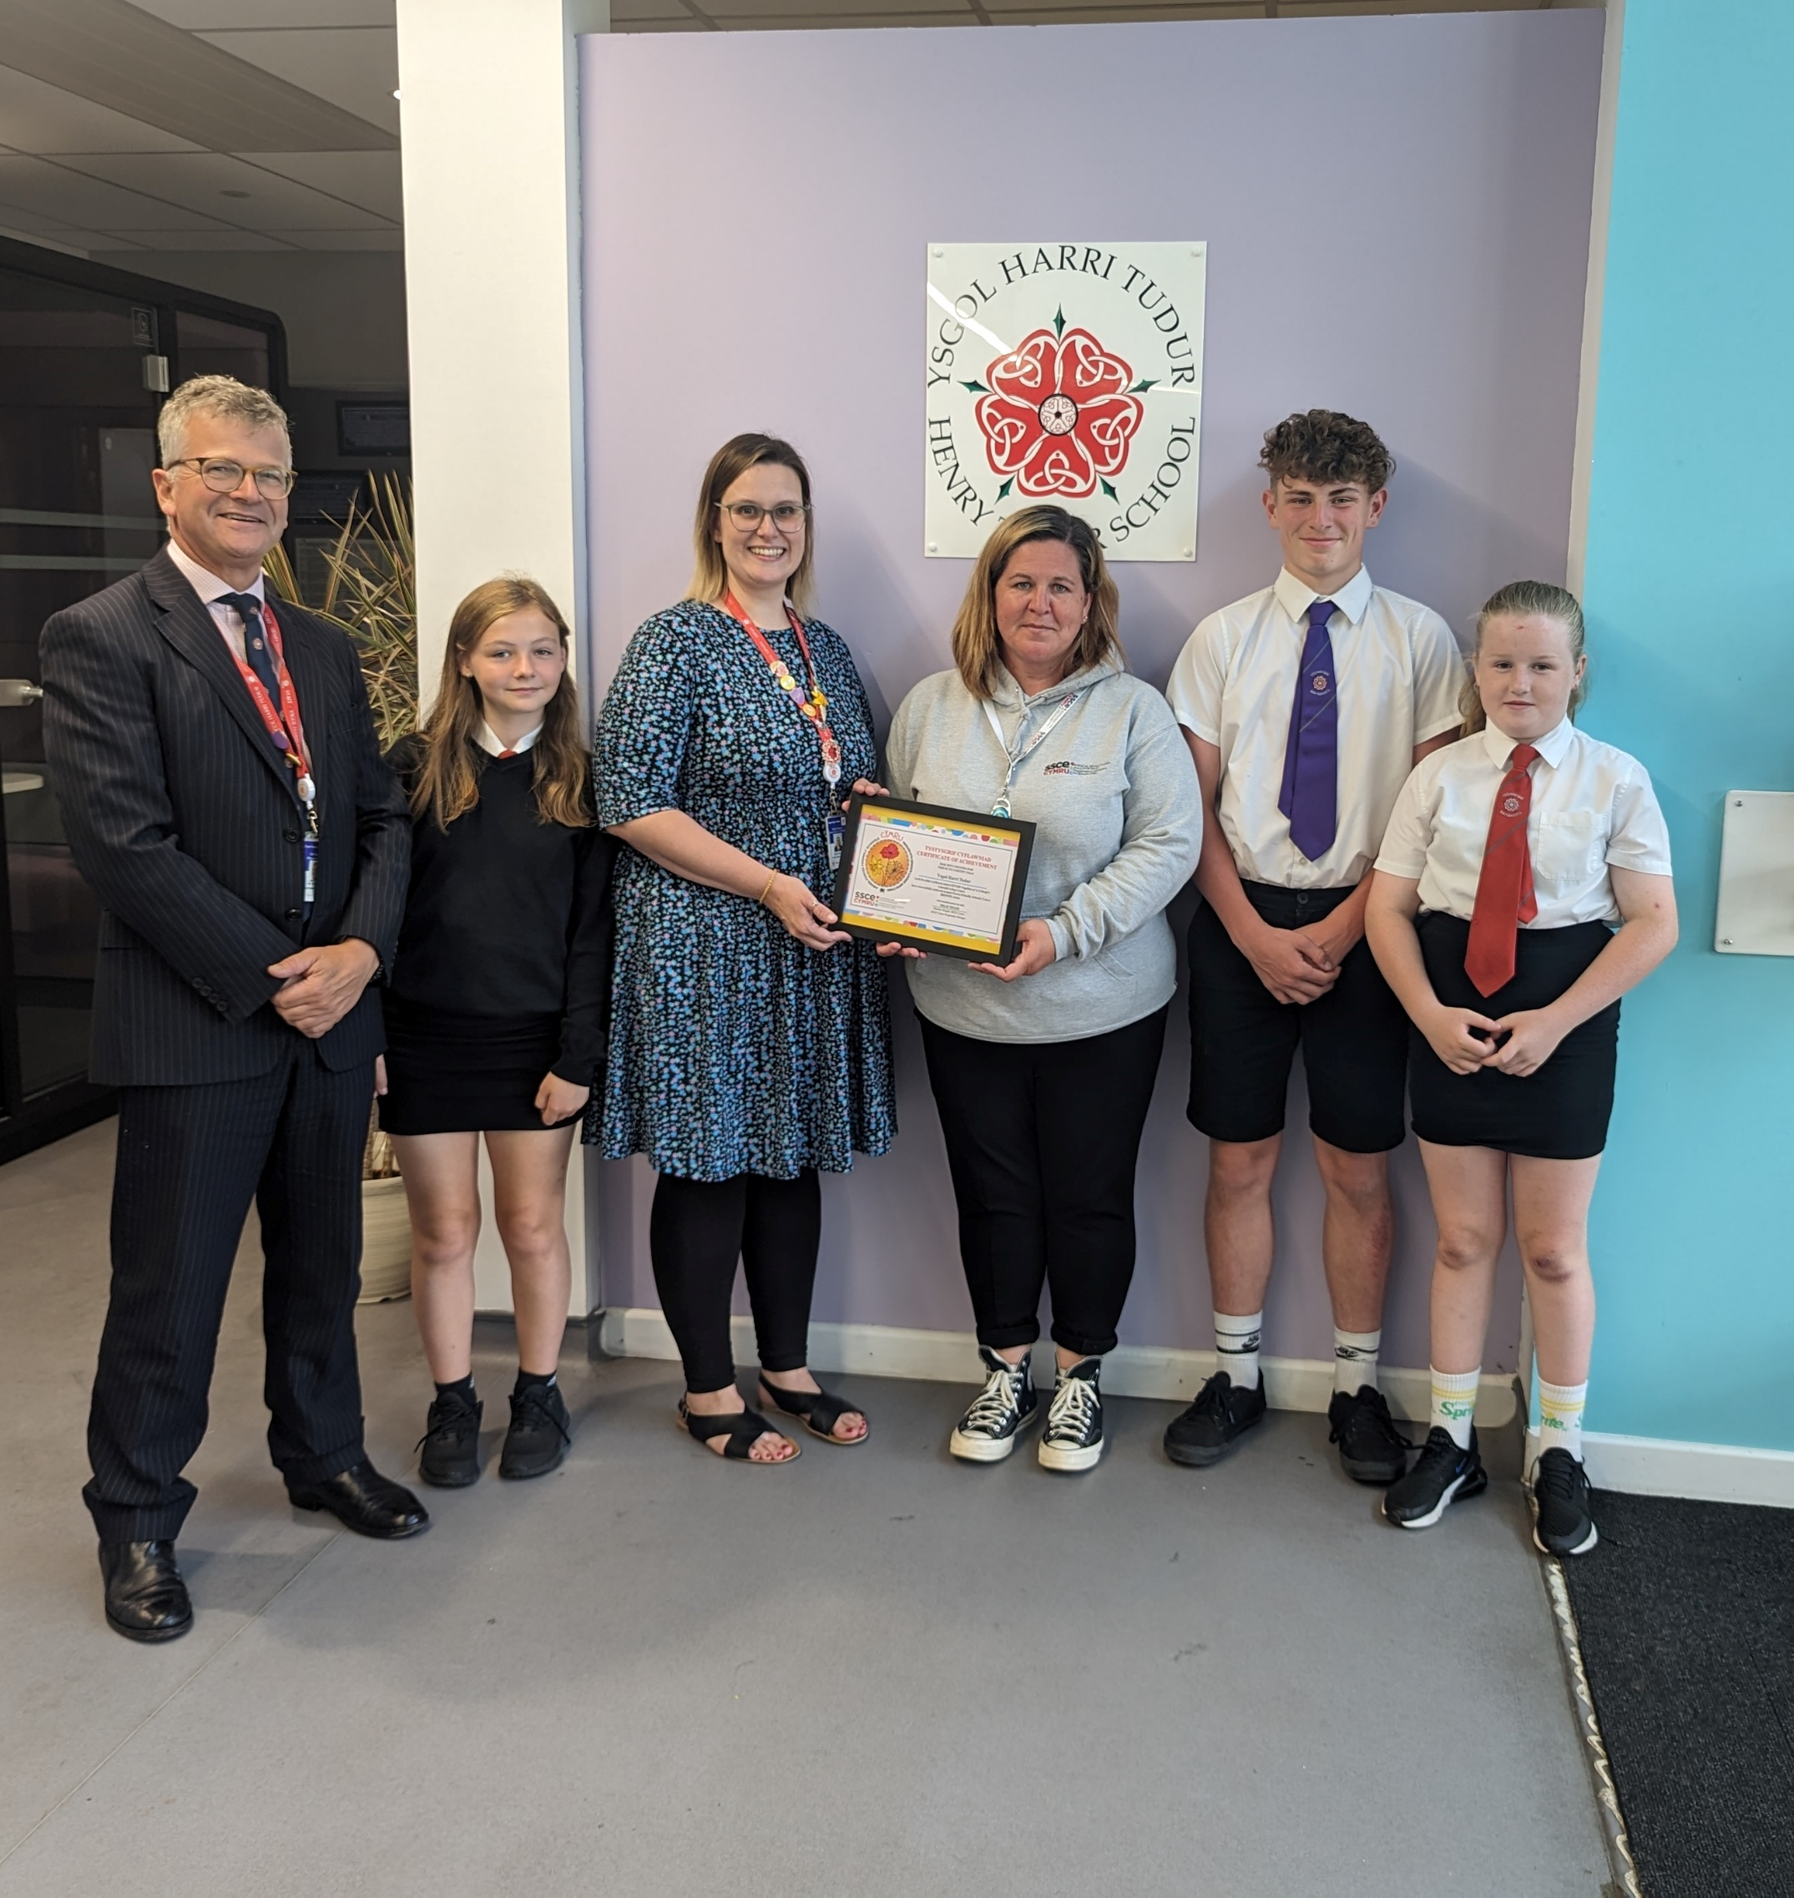
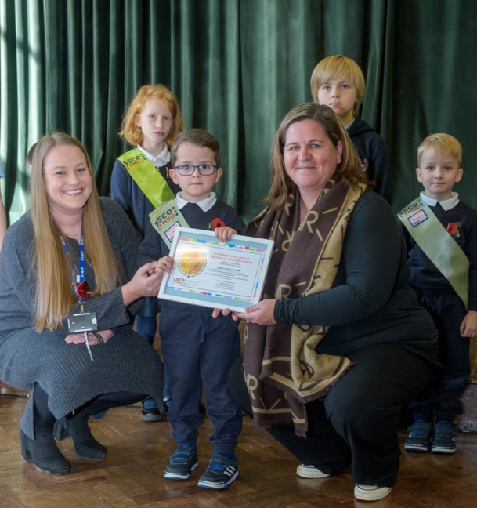
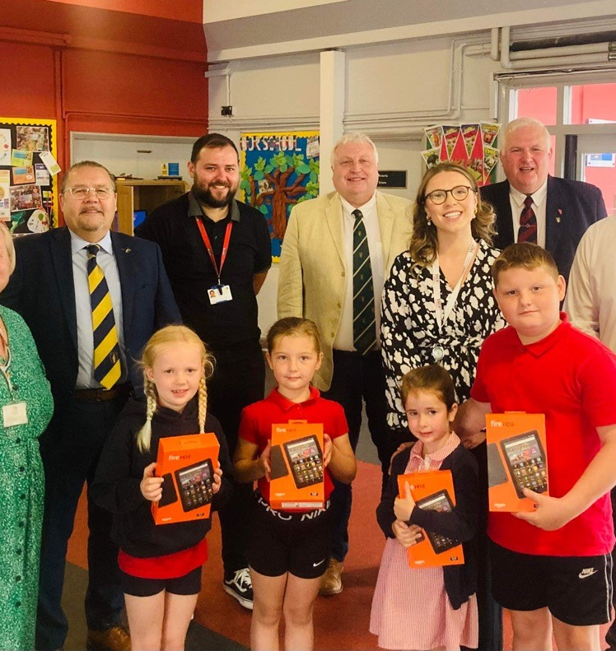
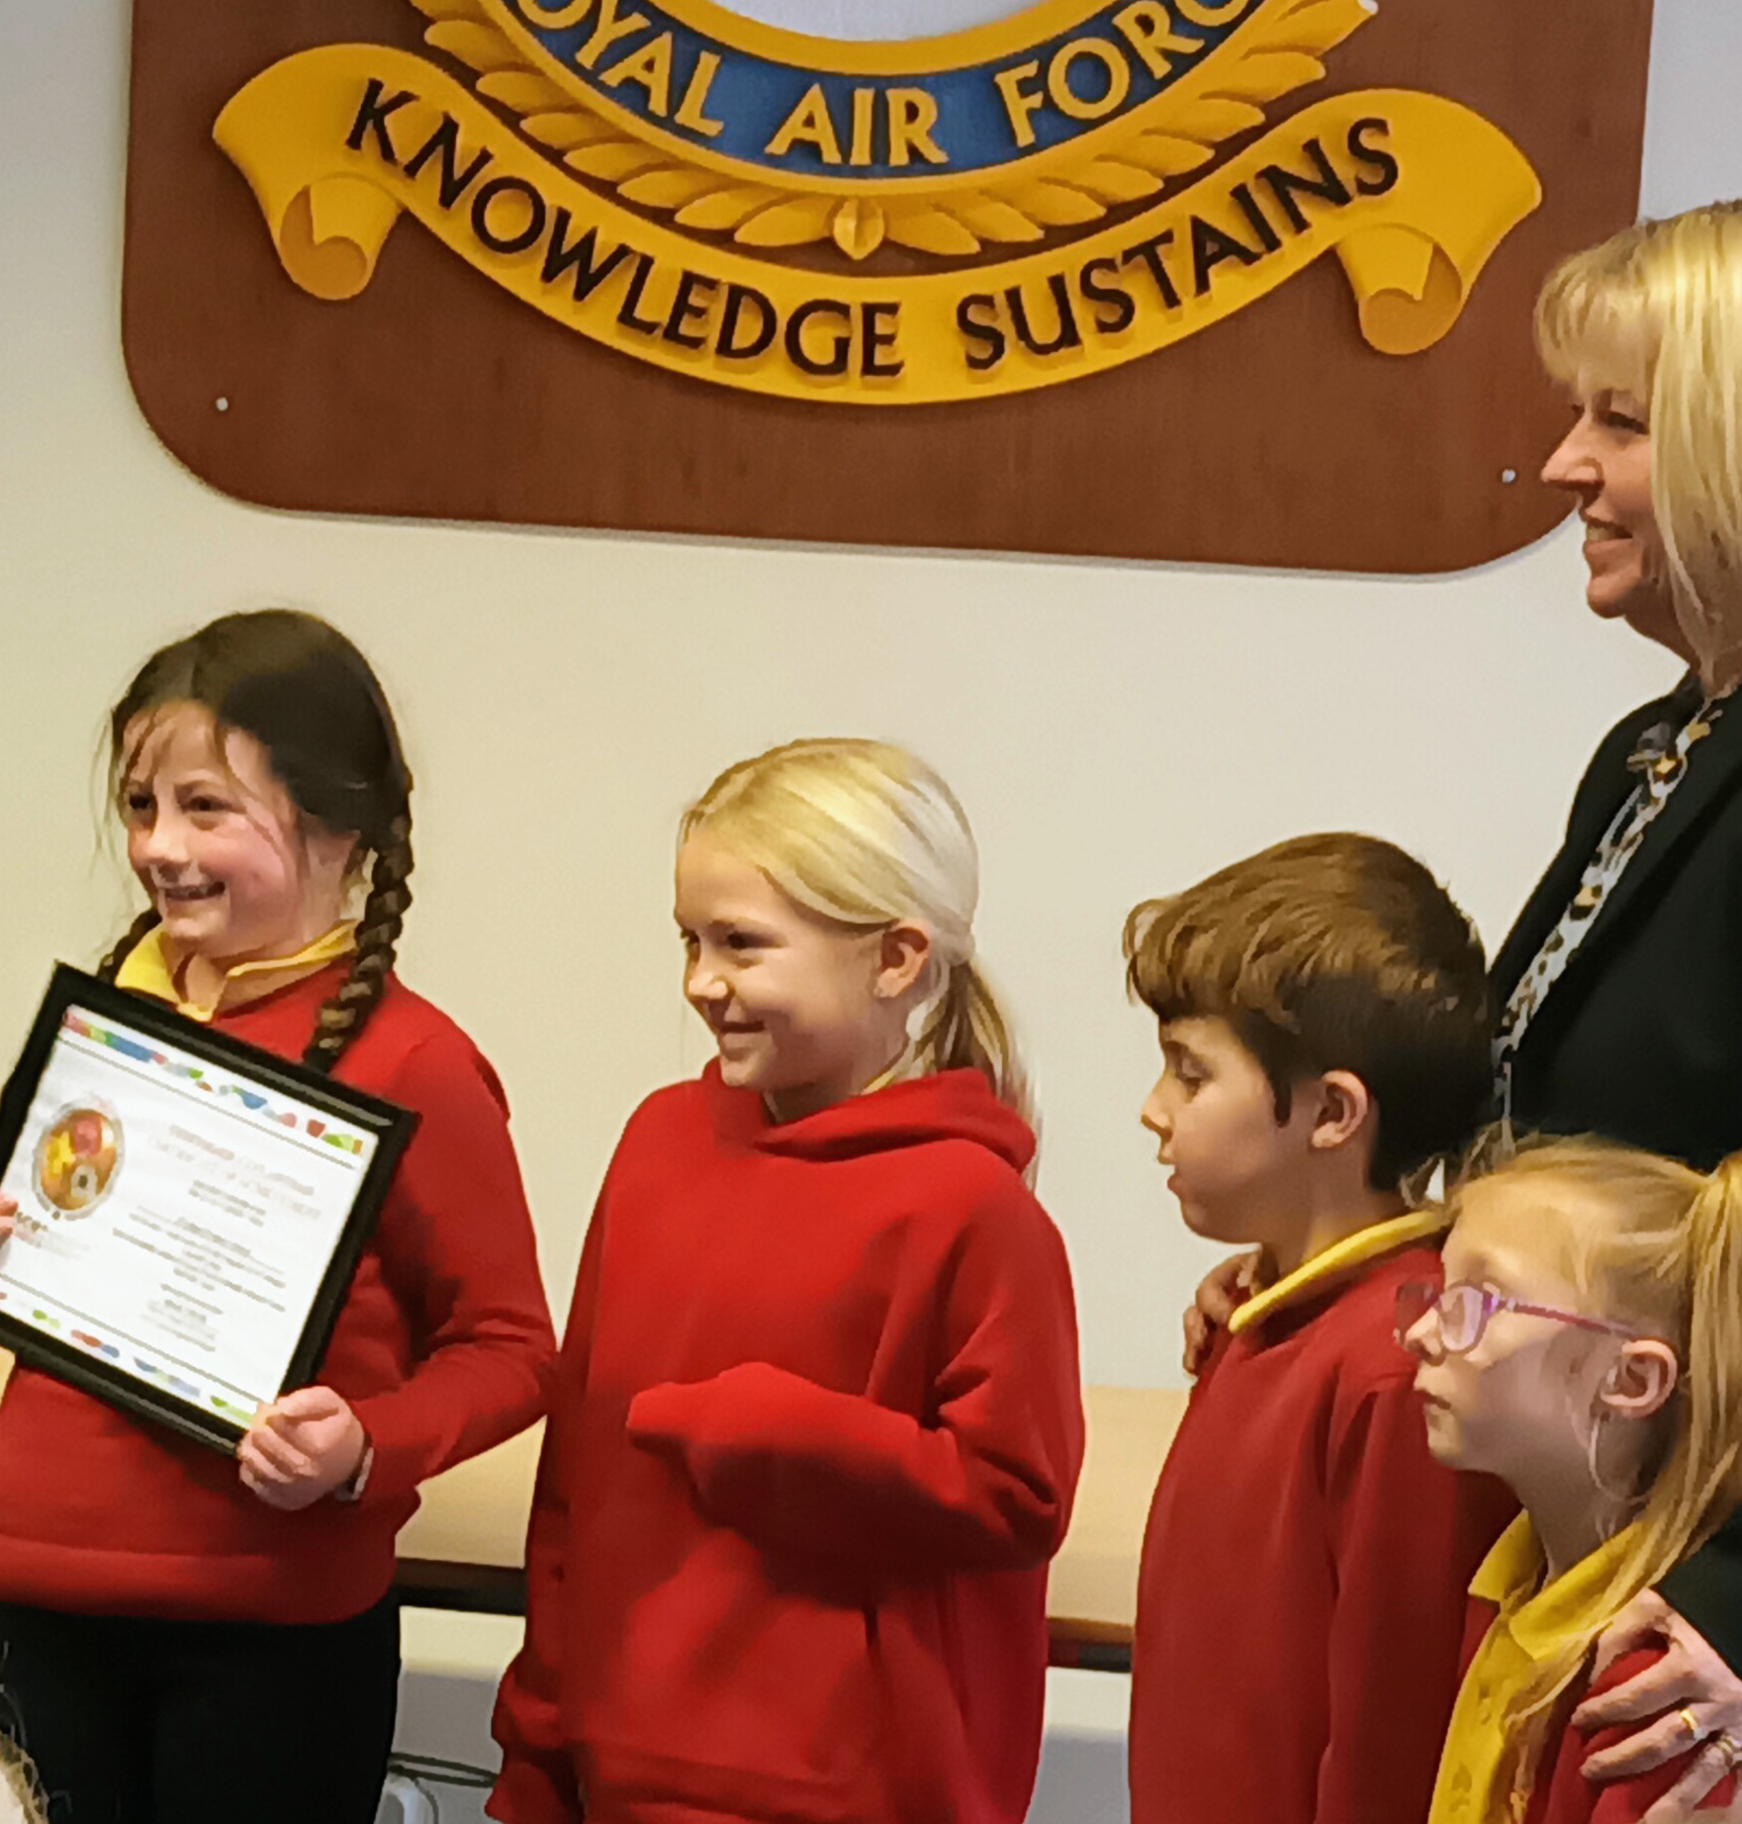
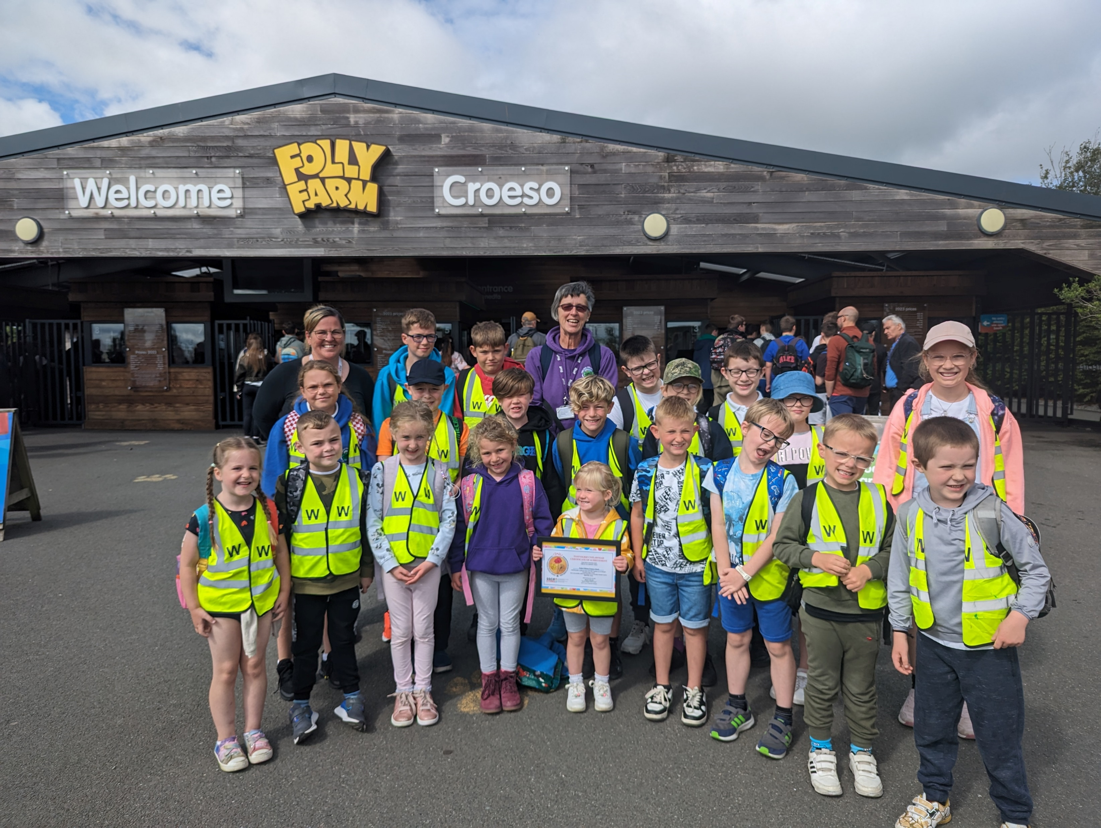
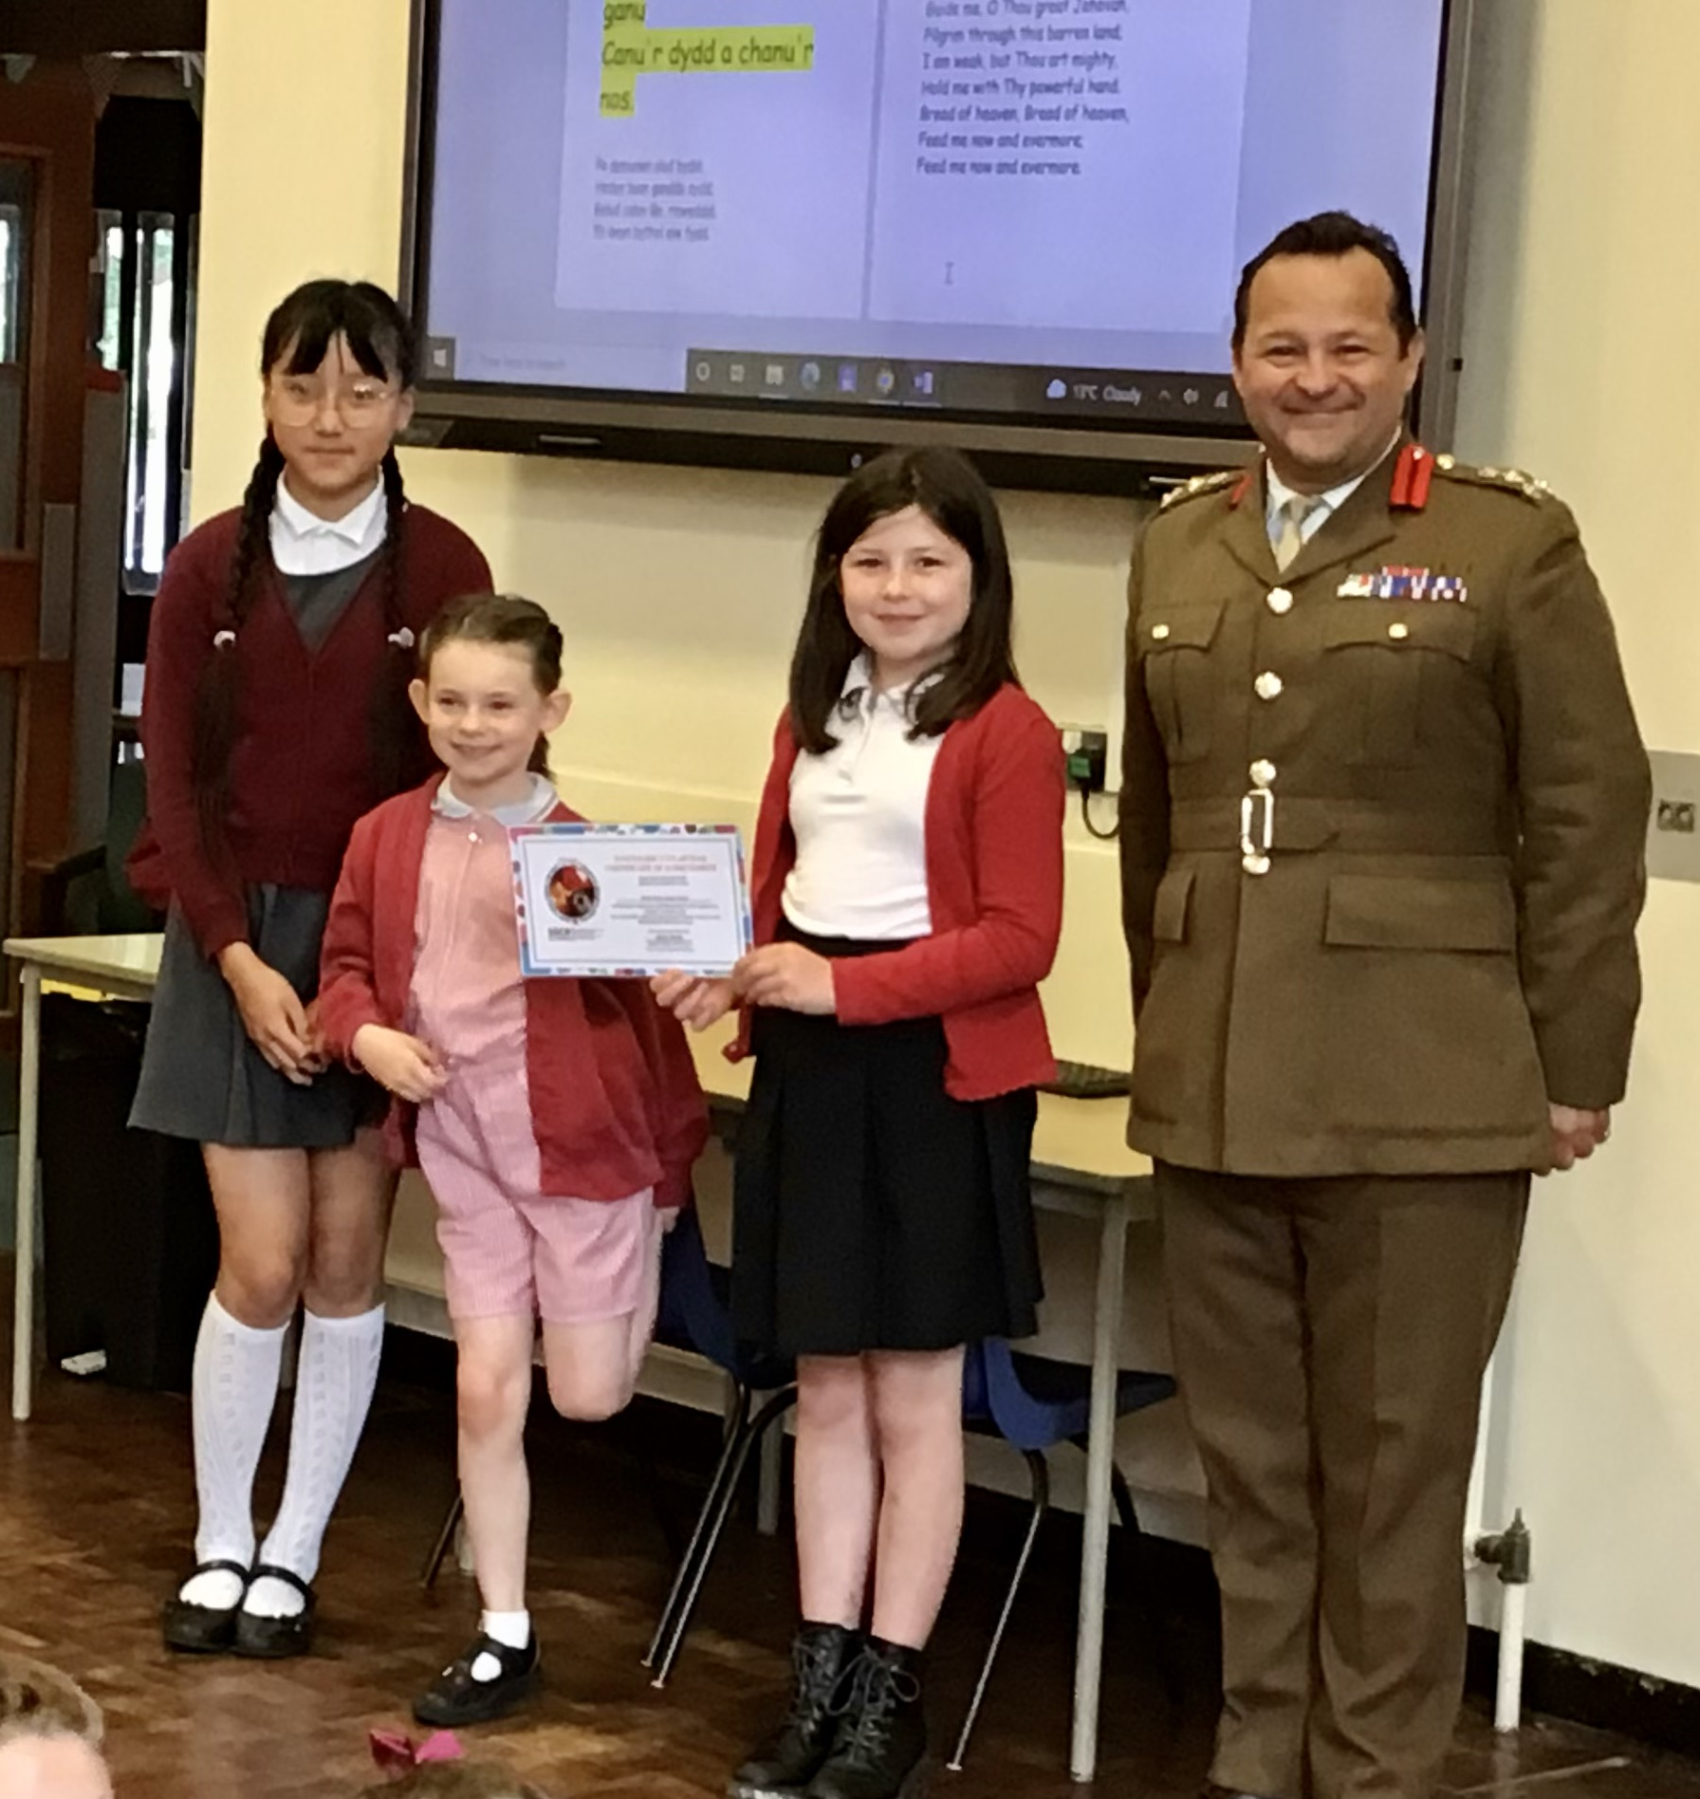
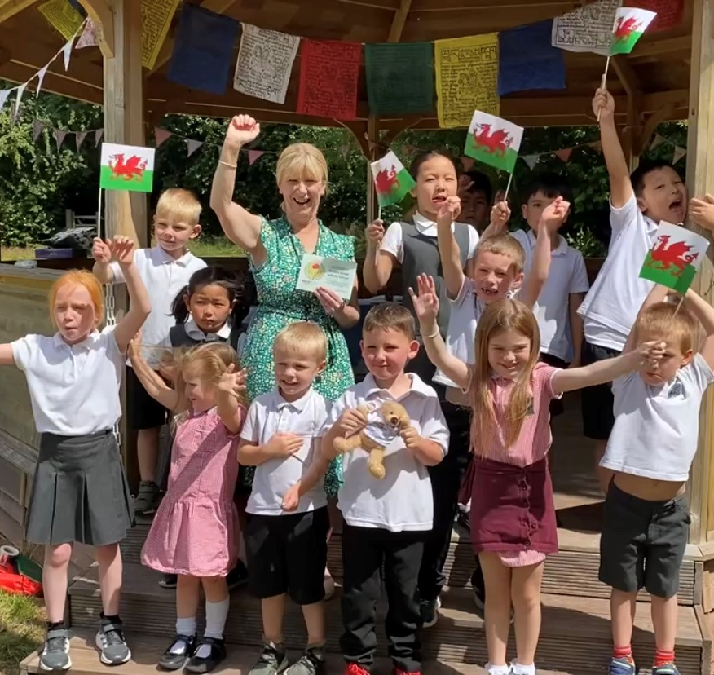
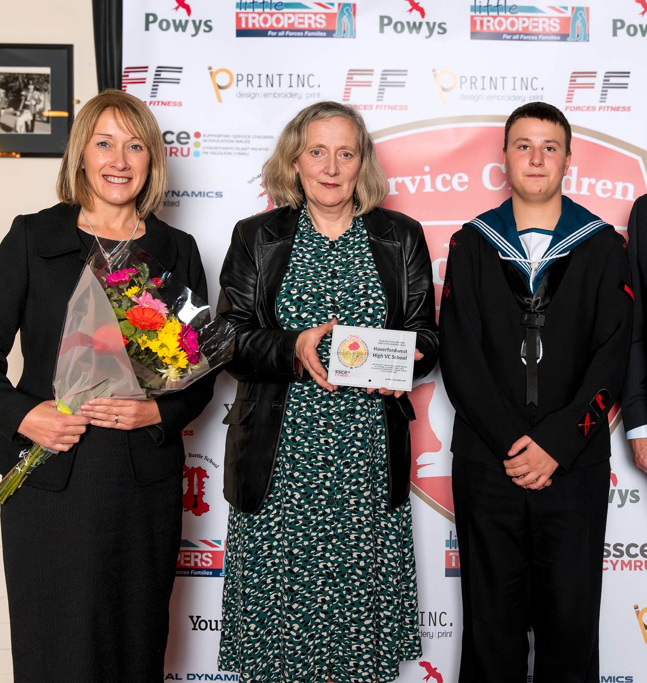
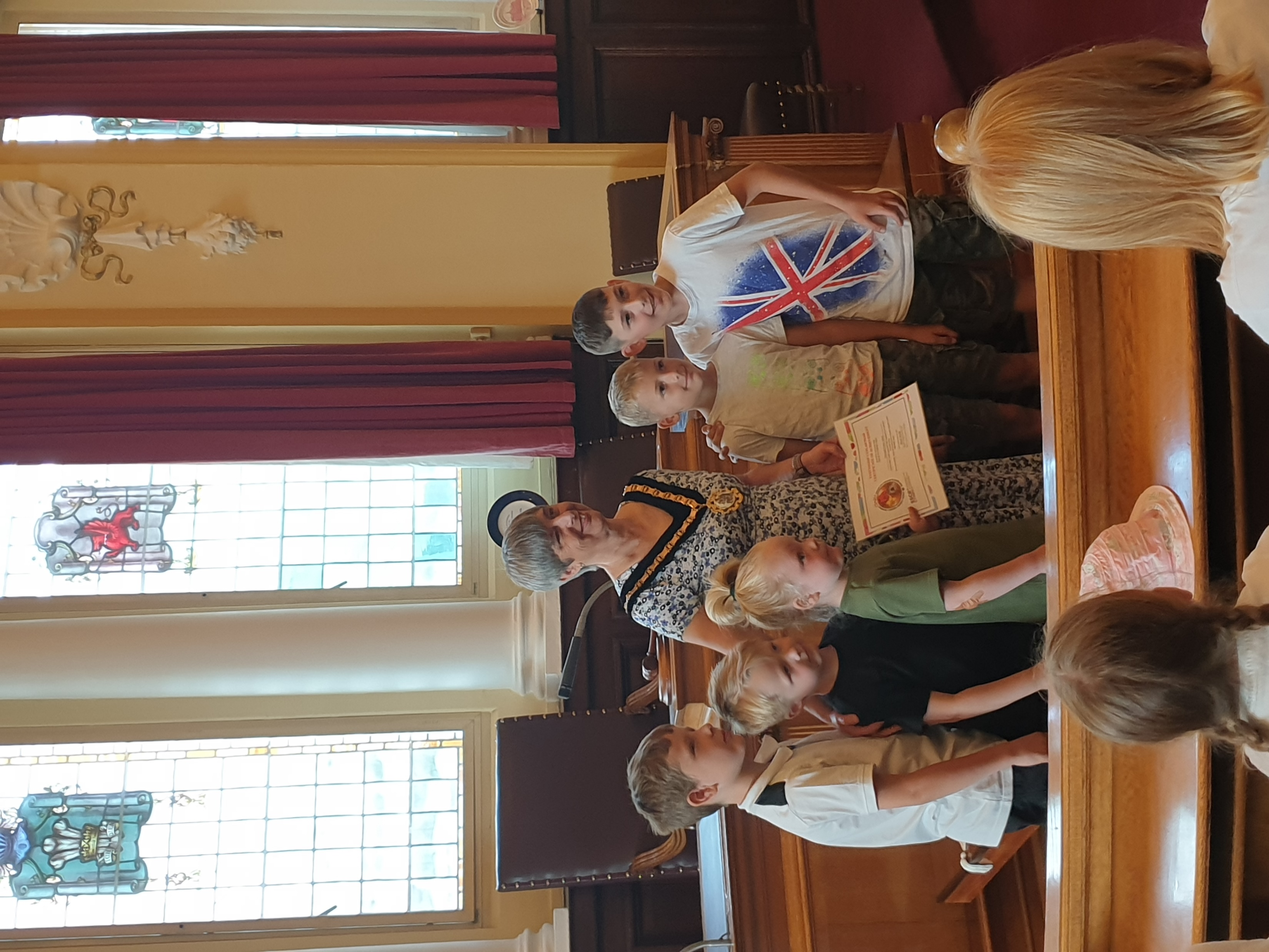
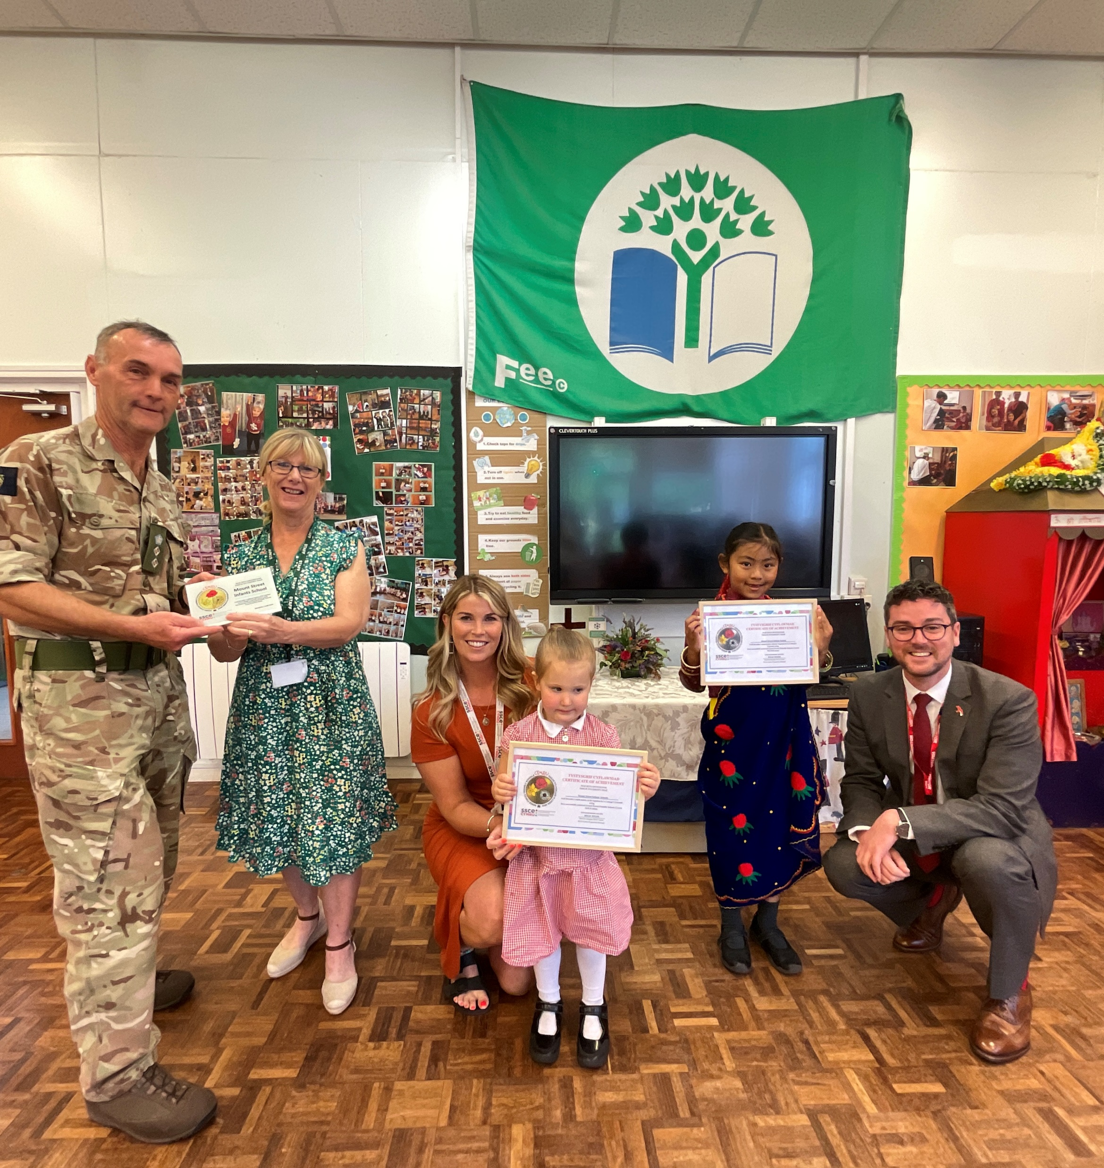
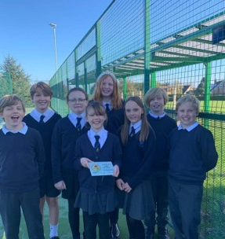
Notes:
Images from some of the schools celebrating their AFFS Cymru achievement!

Slide 12
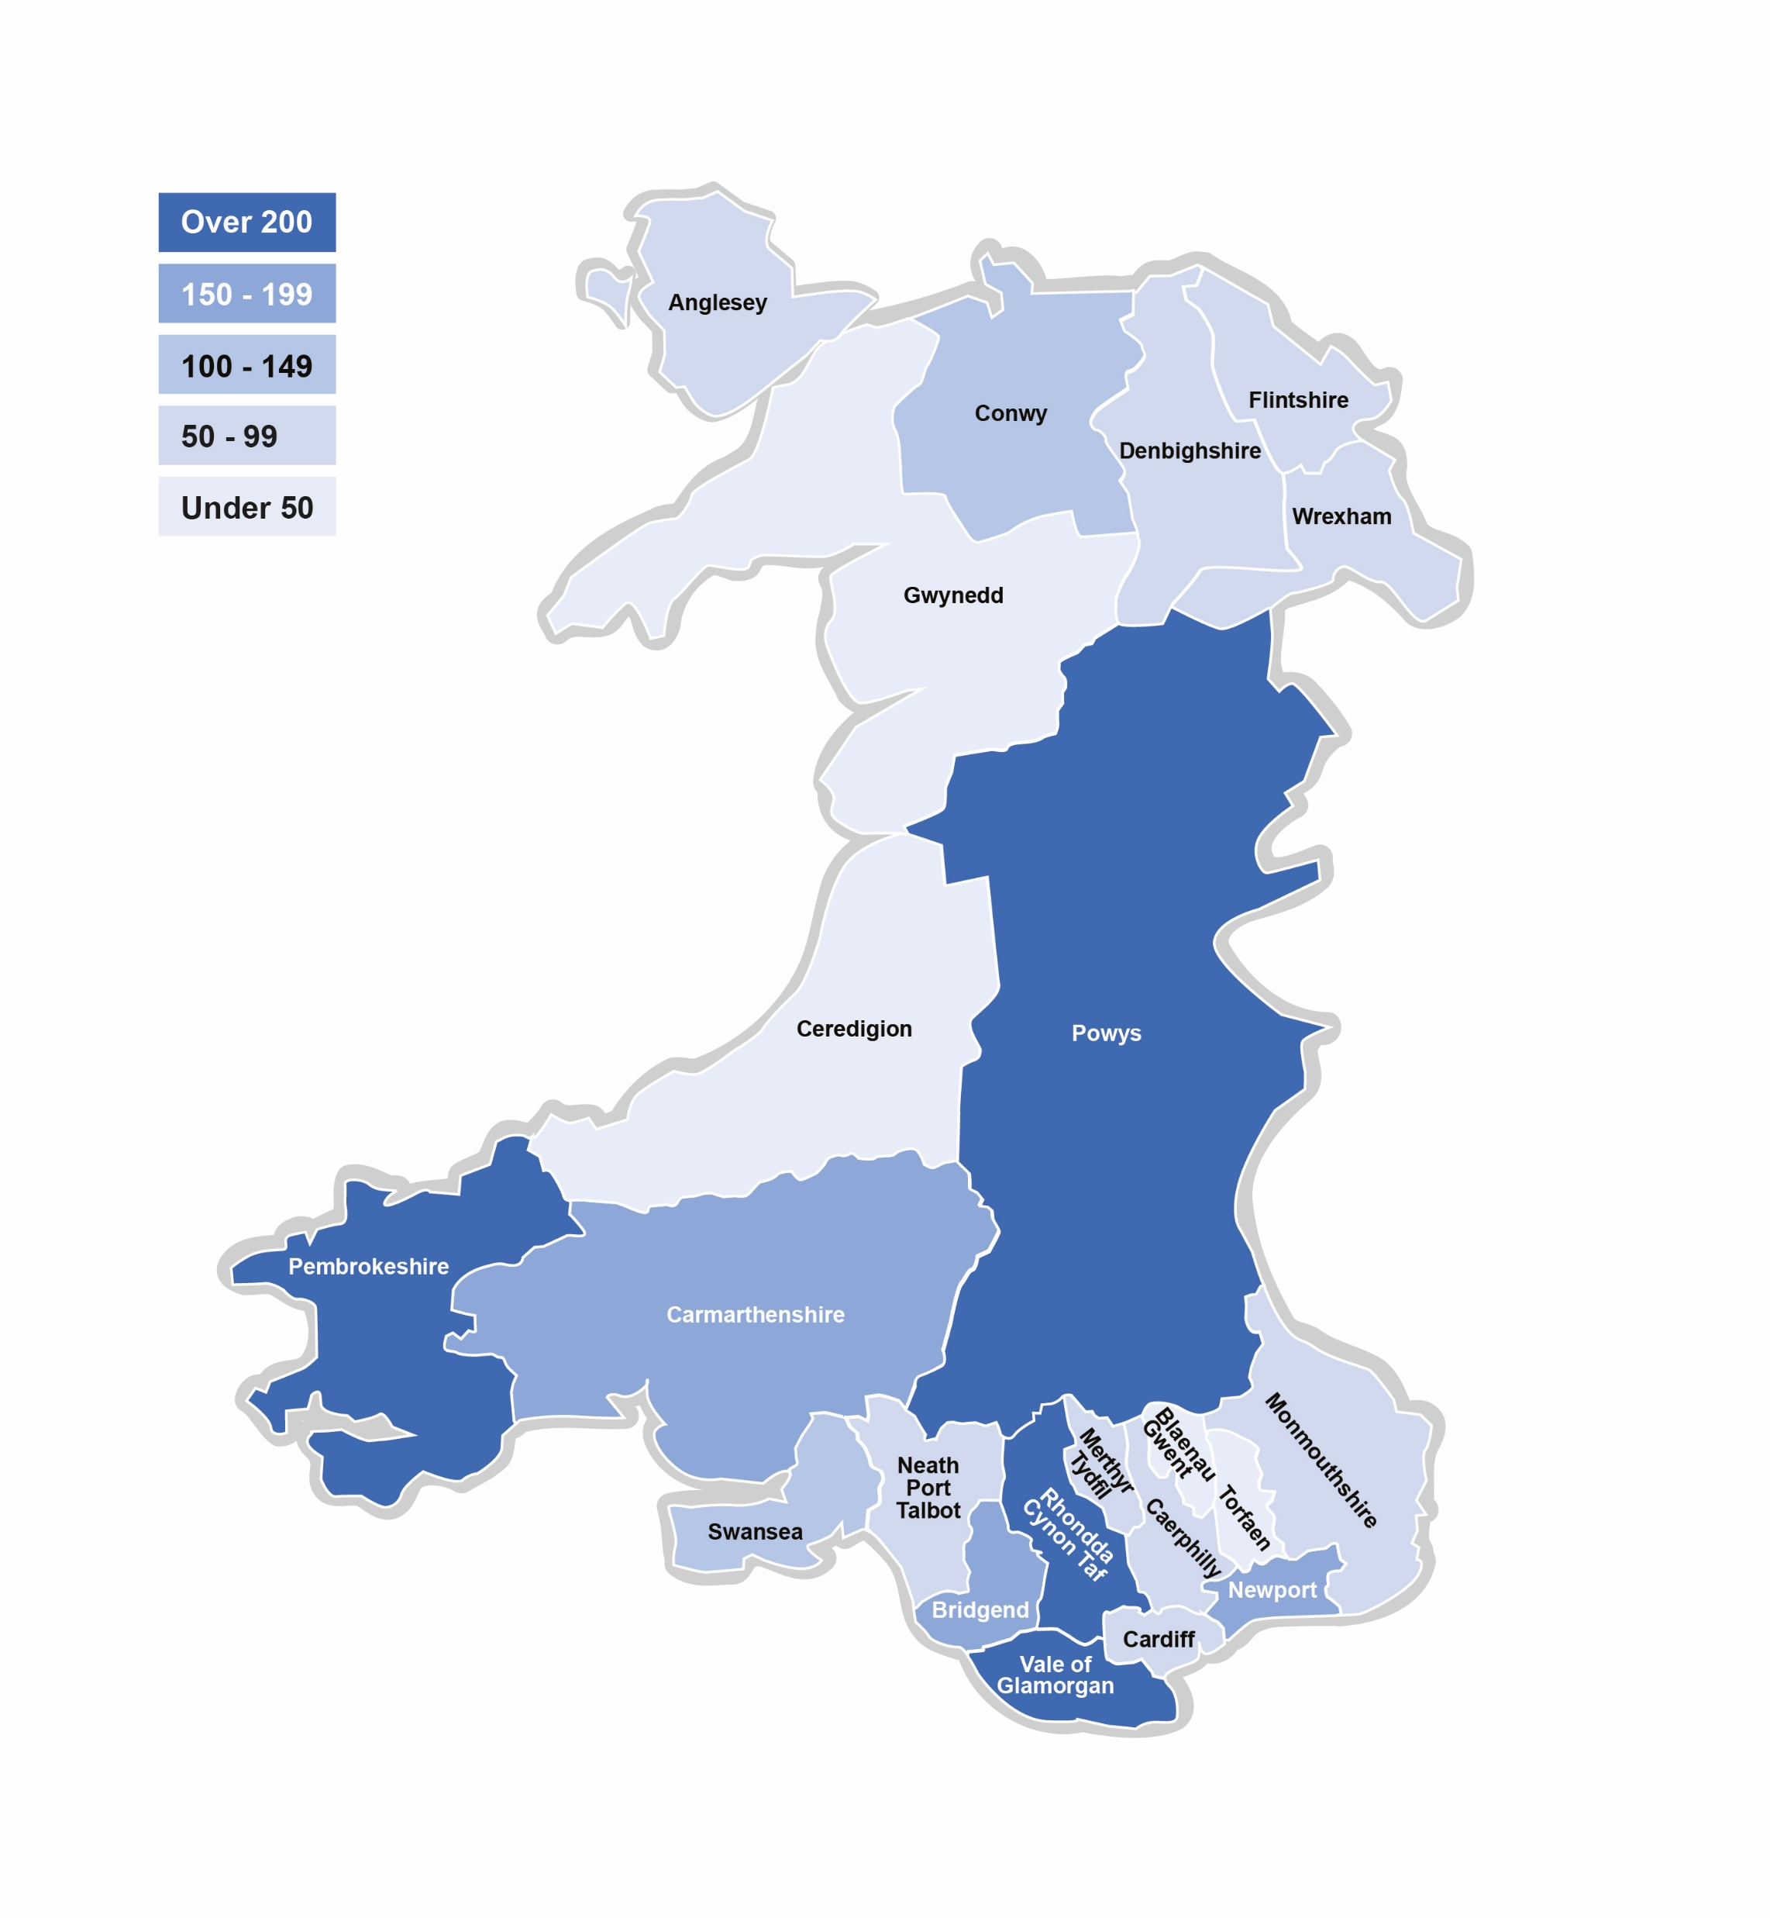
Further information here
Service children data
Welsh Governments definition of a Service child: A ‘Service child’ has parent(s) or person(s) exercising parental responsibility who is/are Service personnel serving: - In HM Regular or Reserve Armed Forces – Royal Navy and Royal Marines; British Army and Royal Air Force, Or - Is an Armed Forces Veteran who has been in Service within the past two years, Or - One of their parents died whilst serving in the Armed Forces and the learner has received a pension under the Armed Forces Compensation Scheme or the War Pensions Scheme.
SSCE Cymru also encourages schools to consider identifying children and young people who don’t fit within the above definition but have a link to the Armed Forces.
2186
Service children
SSCE Cymru online data form for schools
In 543 schools
Notes:
Based on 61% schools in Wales providing data since Sep22.
There is no formal mechanism for data collection in Wales. SSCE Cymru encourages schools annually to identify their SC and inform SSCE Cymru of this data. 4 local authorities in Wales have embedded a process for collection data on SC and share this with SSCE Cymru annually.
SSCE Cymru continues to work with Welsh Government to identifying a way to formally identify Service children.

Slide 13
Further information here
SSCE Cymru e-learning
NOW AVAILABLE
To celebrate Month of the Military Child in April, the SSCE Cymru team launched our highly anticipated NEW on-demand, bi-lingual, e-learning training package on Supporting Service children in education in Wales!!!!
Funded by the Armed Forces Covenant Fund Trust, the SSCE Cymru e-learning training package has been designed to give educators the tools and confidence to understand and support the needs of Service children within their education settings in Wales however, the training can be accessed by anyone who would like to learn more about supporting Service children within education.
This FREE training package consists of nine topics and will take roughly two hours to complete. Your progress will be saved so that you can continue where you left off and revisit the training as required.
“Great links that I will use and very comprehensive. I loved the videos.”
100% of participants found the
e-learning beneficial
Topics included in the e-learning: - Introduction to SSCE Cymru - Armed Forces in Wales - Service children’s experiences - Education in Wales - Identifying Service children - Mental health and wellbeing - Extra-curricular activities - Funding to support Service children - Research and evidence.
“Hearing from the children was great.”
“It was very interesting to learn of the different mobility, deployment and transitions that families experience.”
“Excellent information and support available.”
Notes:
Thank you to all that helped with the development and testing of the e-learning. Please help us to promote this new FREE training package.

Slide 14
Further information here
Upcoming events
Remembrance 2024
11th November 2024 Remembrance honours those who serve to defend our democratic freedoms and way of life.
Notes:
Please help us in raising awareness of the SCiP Alliance annual conference which is being held in Wales this year. Tickets are on sale now.
We will be promoting Remembrance resources / materials on our website and supporting schools with commemorating Remembrance.

Slide 15
Remembrance 2024
Events
Resources
Remembrance Sunday 10th November Remembrance Sunday is a national opportunity to remember the service and sacrifice of all those that have defended our freedoms and protected our way of life.
Teaching Remembrance resources Produced by the Royal British Legion, all resources are: - Available for key stages 1, 2 & 3 and Youth Groups - Made up of lesson plans, bitesize activities and assemblies to support teachers and parents - Free and linked to National Curriculum - Differentiated to provide both support and challenge - Available in Welsh.
Armistice Day 11th November The Armistice, an agreement to end the fighting of the First World War as a prelude to peace negotiations, began at 11am on 11 November 1918. We mark Armistice Day around the UK with a 2-minute silence at 11am on the 11th day of the 11th month.
Army RET Remembrance Live Assembly 09:00-09:30 Friday 8th November The Army Regional Engagement Team (RET) from Wales will be delivering a live assembly of Awareness and Remembrance for all schools. The event is open to all year groups and available in English and Welsh.
Poppy Scotland Poppy Scotland provide a range of FREE learning resources highlighting the importance of remembrance, veterans and the poppy.
RBL Remembrance Live Assembly Monday 11th November The Royal British Legion will host a live-streamed online assembly for ages 9 to 14 (years 5, 6, 7, 8 and 9). This event will bring together art, music, poetry, veteran interviews and more to create a unique, interactive, live-streamed experience helping students understand who, why and how we remember.
BBC The BBC have free teaching resources for Primary and Secondary aged pupils. CBeebies also have an alternative video for the 2-minute silence for young children.
i
See the SSCE Cymru website for further information, resources and events

Slide 16
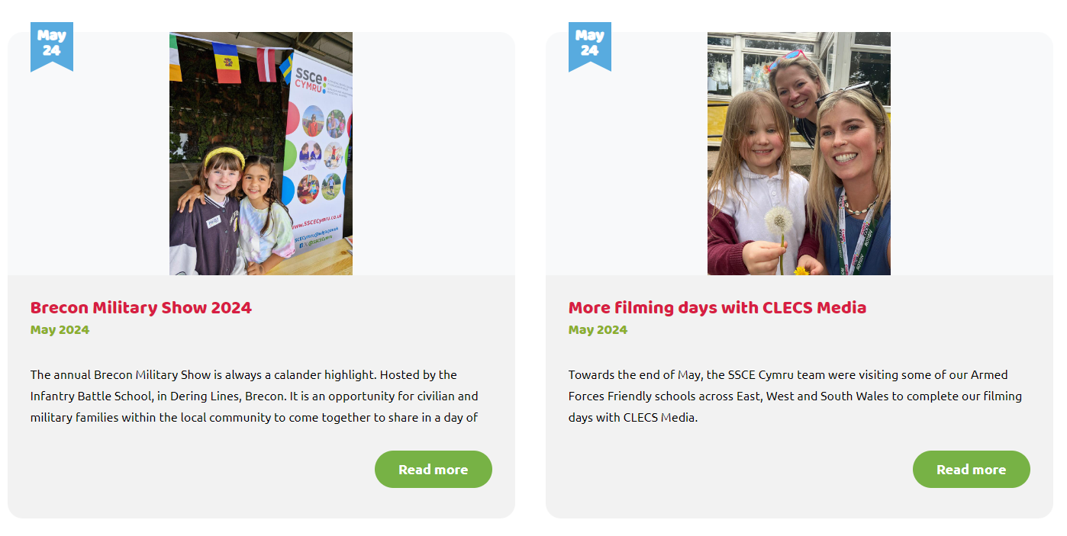
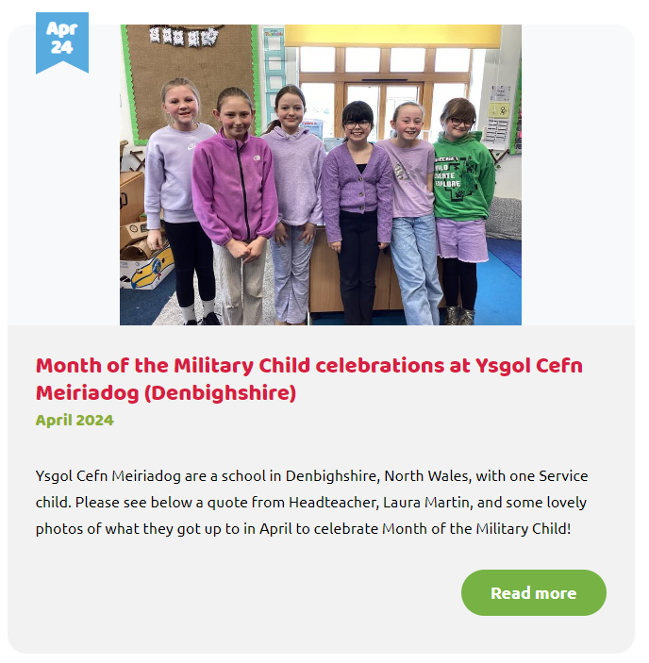
Further information here
SSCE Cymru journal
Notes:
To see further information about what the SSCE Cymru team have been up to, see the journal on our website.

Slide 17
Further information here
Welsh Government funding
2024/25
The Welsh Government Education Directorate have funded the core SSCE Cymru team (Programme Manager and Participation Lead Officer)
SSCE Cymru will continue to administer a grant scheme – the Supporting Service Children in Education in Wales Fund (SSCE-WF) – which is open to all schools and local authorities in Wales
Funding will also continue to be available for the SSCE Cymru Case Management support.
Supporting Service Children in Education in Wales Fund 2024/25
Schools and local authorities (LAs) in Wales can apply for funding throughout the year, to deliver projects specific to supporting Service children in education, linked to the curriculum in Wales.
NEXT DEADLINE: 25th Oct.
£1,000 projects – open to all schools and local authorities in Wales.
£3,000 projects – open to schools who have achieved their Armed Forces Friendly Schools Cymru Bronze status and all local authorities.
Notes:
In 2023/24 the SSCE-WF received 121 applications. We awarded funding for 18 £5k projects and 41 £1k projects from 14 LAs across Wales.
Every unsuccessful application received detailed feedback from the SSCE Cymru team and is encouraged to re-apply in the next round.

Slide 18
Further information here
Grant funding
Service Pupil Support (SPS) programme 2024/25
Armed Forces Education Trust: Collective grants
Administered by the Armed Forces Covenant Fund Trust, the SPS programme awards grants of £5,000 to £80,000 to projects supporting Service children along their educational pathway. Project themes for 2024/25 were: - Closing attainment gaps - Addressing the needs of Service children with ALN - Identifying and addressing the needs of small cohorts of Service children.
2024/25 SPS success 21 grants were awarded across the UK, three (14%) of those were for school clusters in Wales. Congratulations to the successful applications which were led by: - Ysgol Golwg Pen y Fan (Powys) - Llantwit Major High School (Vale of Glamorgan) - Pencoed Primary School (Bridgend). Just under £200,000 was awarded to these school clusters, which was 14% of the total amount awarded across the UK.
This programme is funded by the Armed Forces Education Trust (AFET).
Open to applications all year, the funding aims to help provide educational support for service pupils. Such support is likely to include a specific educational intervention as a result of which the improved educational outcomes of the service children can be demonstrated.
NOTE: The AFET may also be able to help with a grant to assist an individual child to overcome difficulties linked to their parents’ service and mobility.
Notes:
SSCE Cymru supported a number of schools and LAs with their applications for the SPS 2024/25.

Slide 19
Further information here
Funding and support
Case Management support
Schools and education settings in Wales can work with the SSCE Cymru team to access support and funding (if deemed appropriate), throughout the year, to provide interventions for an individual Service child or a small number of Service children (aged 4-16) with specific need/s related to the impact of their Armed Forces lifestyle.
SSCE Cymru funding advice document
The SSCE Cymru funding advice document document provides advice from the SSCE Cymru team for schools and local authorities, to assist them when applying for funding to support Service children / local Armed Forces community. It also includes a checklist of suggested actions to help when preparing and completing a funding application and a list of funding ideas and suggestions.
SSCE Cymru funding drop-in sessions
NEXT SESSIONS: 12th Sep 30th Sep
Led by the SSCE Cymru Programme Manager, these drop-in sessions are available to support schools and local authorities in Wales with accessing funding to support Service children in education. We will raise awareness of relevant grant funding streams, share examples of good practice, answer questions, promote resources and discuss collaboration opportunities.

Slide 20
Further information here
SSCE Cymru drop-in sessions
Every month, SSCE Cymru hosts a series of informal drop-in sessions focusing on specific themes. Come along to any of the sessions that interest you, where members of the SSCE Cymru team will share relevant information, promote resources, coordinate discussions, answer your questions and create opportunities for collaboration.
OCTOBER schedule
Drop-in session themes include: - Armed Forces Friendly Schools Cymru - Service children voice - Funding for supporting Service children - Local authority Action Plans - SCiP Alliance Thriving Lives Toolkit.
Plus additional themes at certain points of the year (i.e. Month of the Military Child, Armed Forces Day).
Tue 1st
2pm SCiP Alliance Thriving Lives Toolkit
Wed 2nd
10am Service children voice (Primary)
3pm AFFS Cymru
Thu 3rd
10am Remembrance
Fri 4th
Mon 7th
10am Armed Forces Friendly Schools Cymru
Tue 8th
2pm Service children voice (Secondary)
Wed 9th
10am Funding for supporting Service children
Thu 10th
10am Local Authority Action Plan
3pm AFFS Cymru
Fri 11th
Mon 14th
2pm Service children voice (Primary)
Tue 15th
3pm Data collection
Wed 16th
10am SCiP Alliance Thriving Lives Toolkit
2pm AFFS Cymru
Thu 17th
3pm Funding for supporting Service children
Fri 18th
10am Armed Forces Friendly Schools Cymru
Mon 21st
2pm Remembrance
Tue 22nd
2pm Local Authority Action Plan
Wed 23rd
2pm Armed Forces Friendly Schools Cymru
Thu 24th
10am Service children voice (Secondary)
Fri 25th
Mon 28th
Tue 29th
Wed 30th

Slide 21
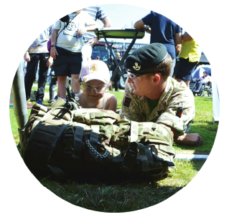
Questions?

Slide 22
Diolch Thank you
www.SSCECymru.co.uk
SSCECymru@wlga.gov.uk

