Slide 1


A Service children pupil voice initiative ensuring local authorities listen to the voices of Service children, enhance their educational experiences, and strengthen their commitment to inclusion, support and the Armed Forces Covenant.
SSCE Cymru Service Pupil Promise - A structured approach to gathering Service children’s voices enabling the creation of a Local Authority Service Pupils’ Promise

Slide 2

What is a Service Pupil Promise
A Service Pupil Promise is a commitment from the Local Authority to support children from Armed Forces families, ensuring we listen to their voices, and strengthen the LAs commitment to the Covenant.
This initiative includes a Service pupil voice workshop/s which aim to ensure that Service children receive the recognition and tailored support they deserve, acknowledging the unique challenges they face, such as mobility, separation, and transition between schools. By working together, a framework can be created that enhances Service children's educational experience and strengthens the local authority’s commitment to inclusion and support.
The aim is to include a diverse range of Service Children from schools across the LA, so to gather a wide variety of perspectives and experiences. The main workshop event allows Service children to interact and socialise with other Service Children from across the county as well as networking opportunities for school staff.

Slide 3



What is a Service Pupil Promise
Following the workshop/s all information will need to be collated and reflected upon and the Service Pupil Promise is written up.
You could then consider follow up school visits or a smaller workshop to finalise the Service Pupil Promise with Service children before publication.
The initiative is ideally aimed at KS2 and KS3 Service children. Ideally there should be a minimum of 25 SC in attendance.

Slide 4
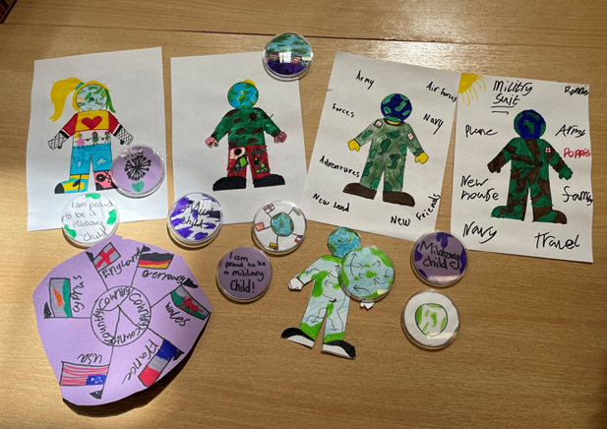
Optional pre-event school based workshops - A structured discussion with a group of Service children
Structured conversation
Have you heard the phrase ‘Service child’ before? Who does it refer to, and why ‘Service’?
Do you think being a Service child is any different to being a civilian child? Why?
Are you proud of having a parent who is, or was, in the Armed Forces? Why do you say this?
What do you consider are the best and worst bits of being part of a military family?
Does your school give you any additional support because you are Service children? If yes, what? (e.g. when you arrive, leave, when mum or dad are away)
Do you think most adults in your school understand what it’s like to be a Service child?
Do you have any ideas for providing even better support to your school’s Service children?
This structured discussion activity has been designed as an optional pre-event for schools to use ahead of an LA wide Service Children Voice workshop. It may be of particular help to schools with larger Service children cohorts, allowing the outcomes to be taken to an LA event by a school’s ‘Service Children’s Ambassadors’ or some representative pupils. The template can also be useful to any school leader who wishes to explore Service children’s views, and is designed with KS2 & 3 pupils in mind. ​
​

Slide 5

LA wide Service children workshop (main event)
Arrival and Welcome – Ice breaker, welcome speech, introductions, overview of the day.
Hearing Service children's views – Poem, video activities
Pros and cons - What are the advantages and disadvantages of being a ‘Service child’?
Celebrating Success - What does your current school do well, or what did previous schools do well, to celebrate your Service child experiences / lives and to support you as a Service child?
Identifying and overcoming challenges – What are the main barriers/challenges? What could schools do to help overcome these? Big Empathy Drawings, Videos, Assemblies.
Improving provision – School/Group Pledge, our vision for the perfect school, post card request to headteacher / council.
Reflection – should schools reat Service children any differently to other pupils?
The Service Pupil Promise initiative includes a main event, a Service children pupil voice workshop lasting approximately 4-5 hours. It will include activities based on the themes listed here.

Slide 6
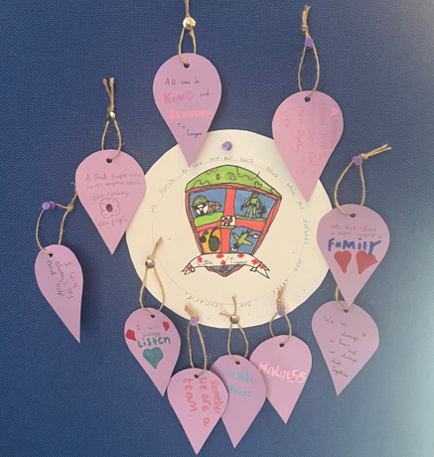
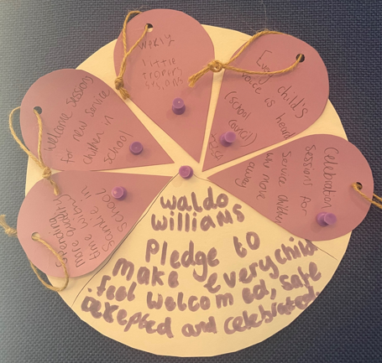
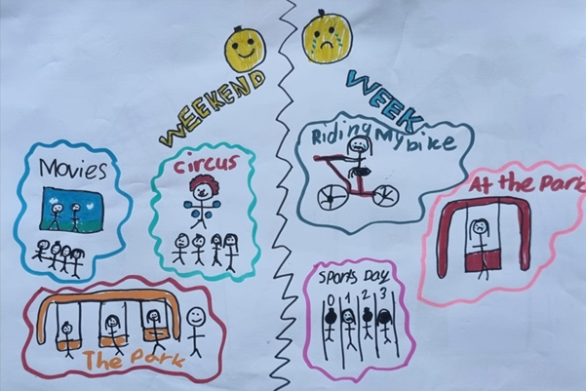
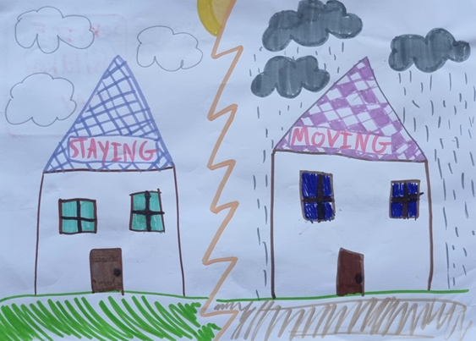
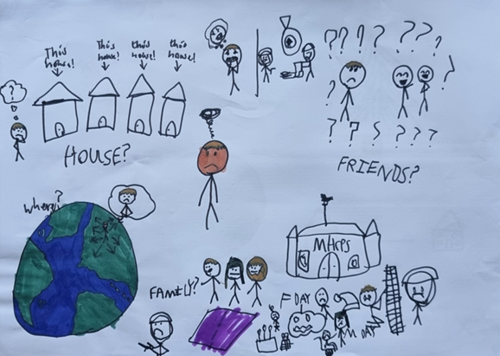
LA wide Service children workshop (main event)

Slide 7
LA wide Service children workshop (main event)
How will you be supported?
SSCE Cymru will provide a checklist and all template resources required for the workshop/s as well as the production of the final Service Pupil Promise.
You will be supported by the SSCE Cymru team in the planning, delivery and write up of your LA Service Pupil Promise.
SSCE Cymru will support with funding. This could be used to cover the costs of a venue, food, resources, staff/staff cover, transport etc.
Who, where, when?
The Service Pupil Promise workshop/s have been created with KS2 and 3 children in mind although KS4 could certainly be involved (in the activities themselves or to support with facilitating). We recommend at least 25 Service children are involved so a range of experiences can be gathered but the number could be far greater. Our pilot event included 60 SC.
Other than that, consider what will work best for you as a LA.
Who - You may wish to include a small number of SC as representatives from as many schools across your LA as you can. You equally may wish to invite and include every SC and run a much larger event.
What – templates of resources are provided from which you can choose activities. Depending on your choices you may need to print and order additional physical resources. You may wish to provide food e.g. a pizza van. You could consider using funding to buy a small gift for your SC.
Where – Depending on numbers and logistics you could consider using a school hall, youth centre, local Armed Service building e.g. cadets, or even a fancy hotel.
When – our initial funding will cover events taking place before April 2026.

Slide 8
Service Pupil Promise – Initial Planning
Where to start
Following your initial meeting with SSCE Cymru take some time to reflect on the documents emailed across, particularly the check list (and initial planning points included here) as well as the main event plan and PowerPoint to allow you to get a feel for the main event and how this could run in your LA. Arrange any follow up meetings required with SSCE Cymru for further advise and support.
1.1.3. Decide on the size of the event considering the data above. ​
Number of SC to be involved (recommended minimum 25). ​
Age range (recommended KS2-3)​
Number of schools / numbers of SC from each school
1.1.4. Decide whether to run pre-events in schools.
1.1.5. Identify staff to facilitate the event e.g. LA (Participation officers, Youth leads, Armed Forces Covenant Liaison Officer (AFLO)), SSCE Cymru, Armed Forces (Welfare Officer, Community Development Officer) (recommended ratio1:8).
1.1.1. Familiarise yourself with the key Service Pupil Promise materials
SSCE Cymru Service Pupil Promise Event Plan
SSCE Cymru Service Pupil Promise Event PPT
SSCE Cymru Service Pupil Promise Pre-event activity – A structured discussion with a group of Service children
SSCE Cymru Service Pupil Promise Pre-event activity PPT
SPP Email for schools
1.1.6. Decide how school staff might be involved e.g. will they take part in the event alongside the Service children, will they have an opportunity to meet as a network separately?
1.1.7. Set proposed date. Check calendarised dates within LA e.g. school holiday, INSET, School events.
1.1.8. Identify potential venues, food, prices etc.
1.1.2. Identify number of Service children (SC) within the LA and number of schools with Service children.
1.1.9. Arrange an initial facilitators meeting

